Slide 1
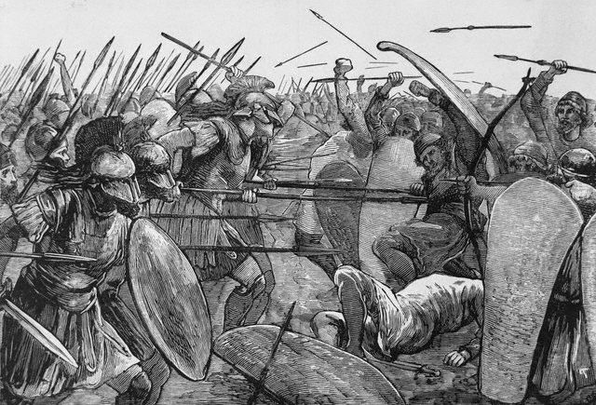
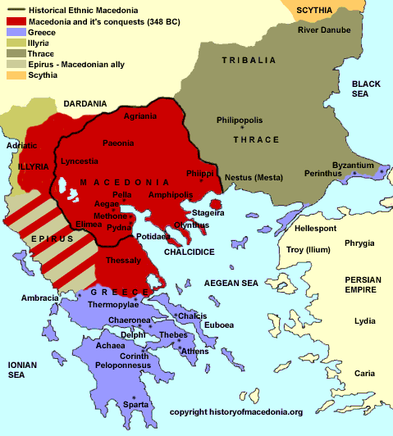
Alexander the Great (almost as great as Yip)
Peloponnesian War – Athens, Sparta & then Thebes waged wars to dominate Greece
- no unity in Greece w/ Persian interference
Macedonia finally brings unity to Greece under Philip of Macedon
Macedonia was area north of Greece
occupied by people closely related to Greeks
strong warlike people ruled by kings

Slide 2
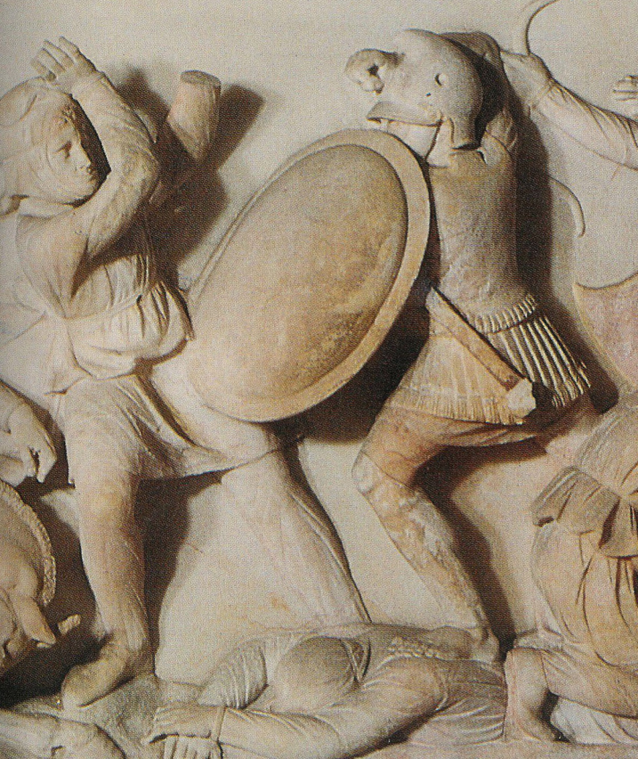
Alexander the Great and the Hellenistic World
359 BCE - Philip becomes king
as a youth he was held hostage for three years in Thebes
came to admire Greek lifestyle and Greek military organization
Three Goals
build a strong army
2. unite Greece
conquer Persia
recruited first regular paid army in Macedonian history → professional army
did not have to depend upon unruly nobles to supply troops
- used landowners as well-trained cavalry and peasants as infantry in well-trained and equipped phalanx

Slide 3
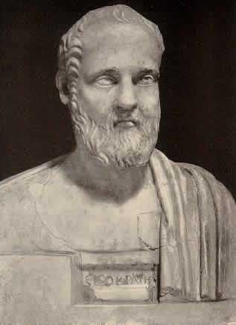
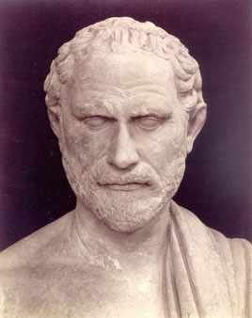
Alexander the Great and the Hellenistic World
after unifying Macedonia, he set out to conquer the surrounding area
began unifying the Greek city-states
some people supported him → Isocrates who wished for Pan-Hellenism (united Greece)
•- others opposed him → most notably Demosthenes
argued to Athens to unite against Macedonian threat
take away Greek liberty → Philippics
did rally some support but Greek disunity betrayed Greece

Slide 4
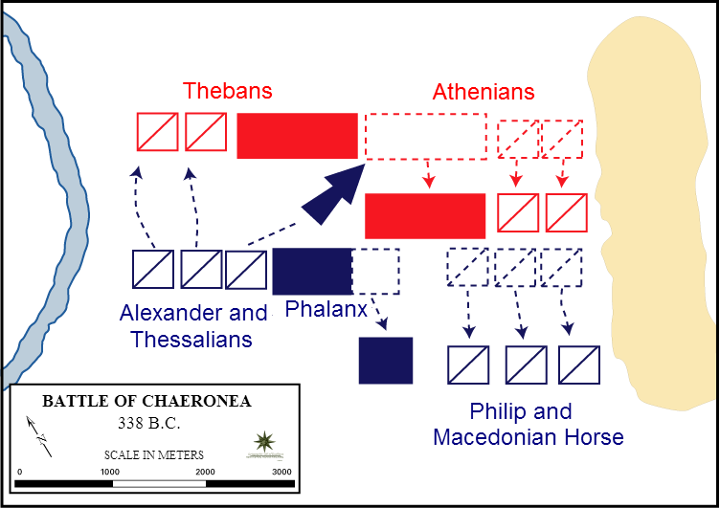
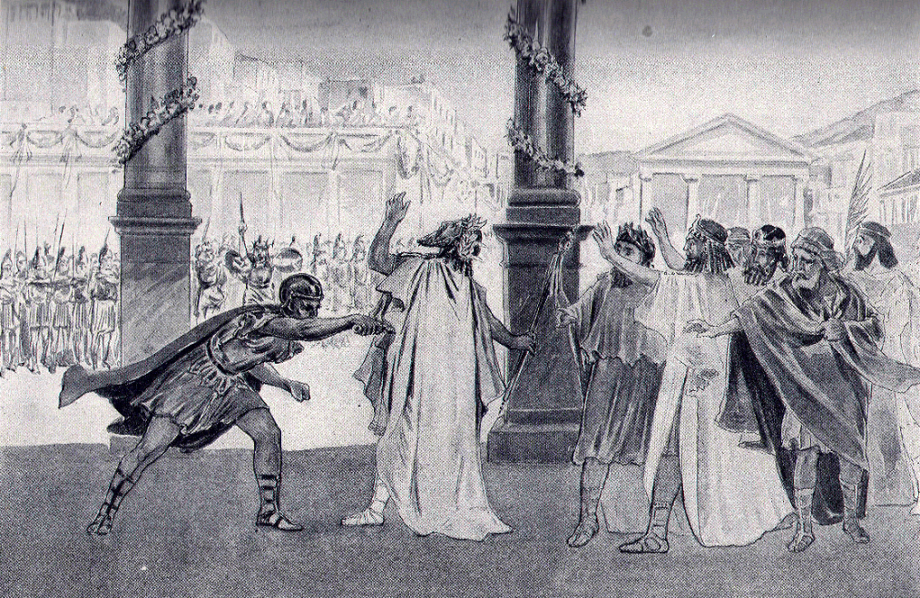
Alexander the Great and the Hellenistic World
combined Theban & Athenian army defeated at Battle of Chaeronea in 338 BCE
Philip now master of all Greece
Greece were at last united again but they had lost their independence → ruled by a foreign power
Philip never achieved his last goal
at wedding of his daughter in 336 BCE, he is assassinated by body guard
Alexander? Wife?

Slide 5
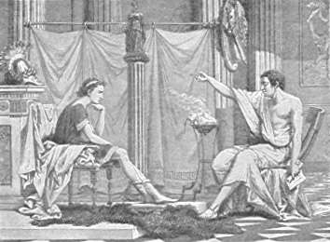
Alexander the Great and the Hellenistic World
Alexander the Great succeeds his father and has an even more remarkable career!
while Alexander and his father disagreed a lot, Alexander received the best training & education → Aristotle
two-fold education: 1. Military training in Macedonian army and formal education w/ Aristotle
gave him military skills and lifelong appreciation of culture
became the greatest military campaigner of all time - NEVER LOST A BATTLE!!
troops willing to follow him anywhere
often faced formidable odds and still won - seldom had numerical advantage

Slide 6
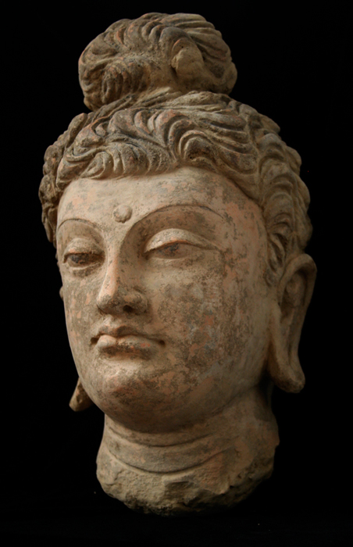
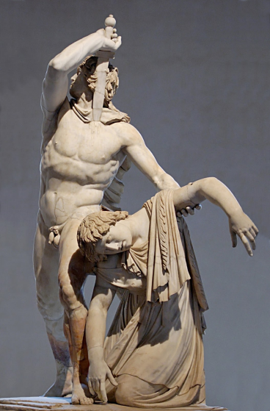
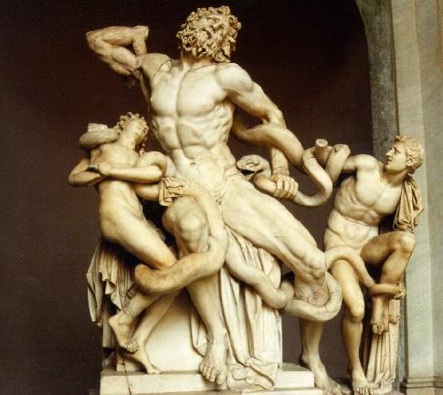
Alexander the Great and the Hellenistic World
saw himself as a god
had father’s extraordinary military skills & his mother’s mystical-religious views
dreamed of a HELLENISTIC EMPIRE (Greek-like)
connected the east & west → best features of his beloved Greek culture & Persian culture into a unique world

Slide 7
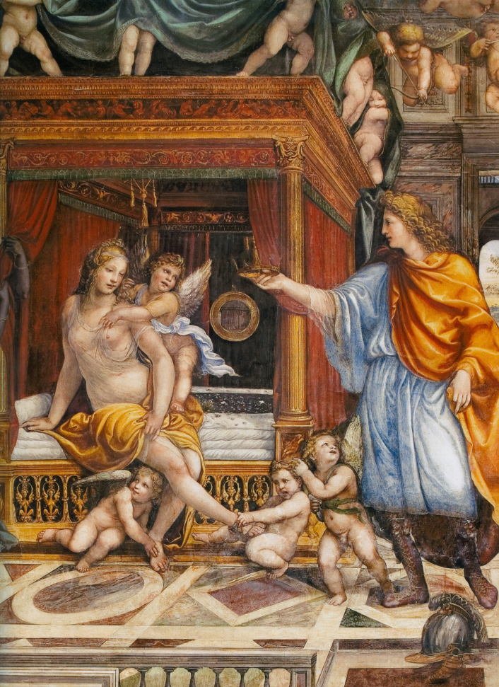
Alexander the Great and the Hellenistic World
Sought to achieve it in three ways
build new cities as centers of culture - would build more than 70 cities (most named Alexandria) → centers of learning and history
2. merge Macedonians & Persians into one ruling class by intermarrying his officers with Persian royalty → Alexander marries Darius III’s daughter, Roxana
wanted his subjects to view him as a god-ruler
difficult for Persians to accept this
easy for Egyptians who always saw their pharaoh as a god
easy for Greeks b/c they thought that some heroes became gods
One-World Vision

Slide 8
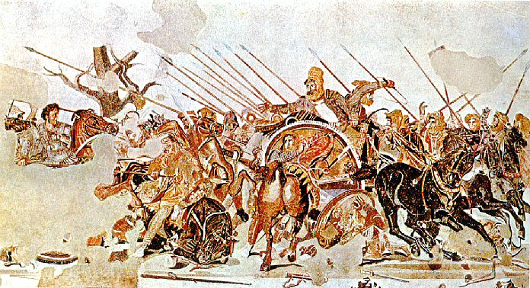
Alexander the Great and the Hellenistic World
Alexander’s conquest
336 - quickly crushes all rebellions in Greece & consolidates power
334 - sets out with 35,000 soldiers to conquer Persia
334 - wins Granicus → takes Asia Minor
333 - wins Issus → captures Palestine & Egypt
- seen as conquering hero and named pharaoh
331 - wins at Gaugamela and Darius’ men will kill Darius

Slide 9
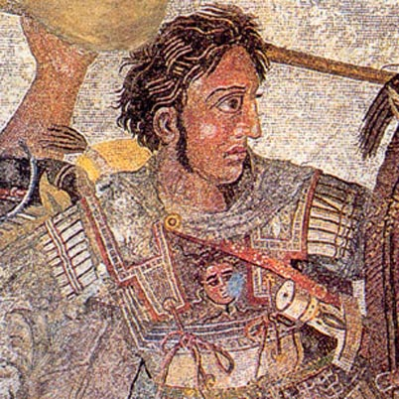
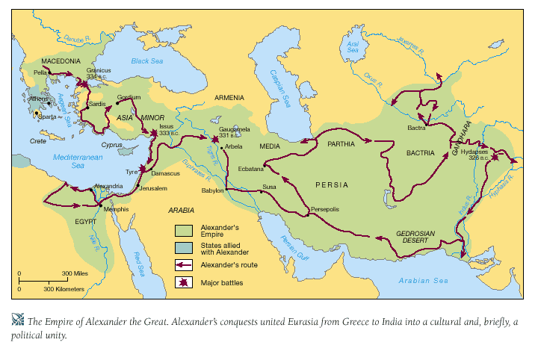
Alexander the Great and the Hellenistic World
becomes “king of the kings”
assumes role of Persian emperor → age 25!!
Alexander’s push to India
not satisfied with Persian empire
wanted to go to the “end of the world
led his troops for four years to Indus River
wanted to conquer northern India of Ganges River valley
met little resistance

