Slide 2
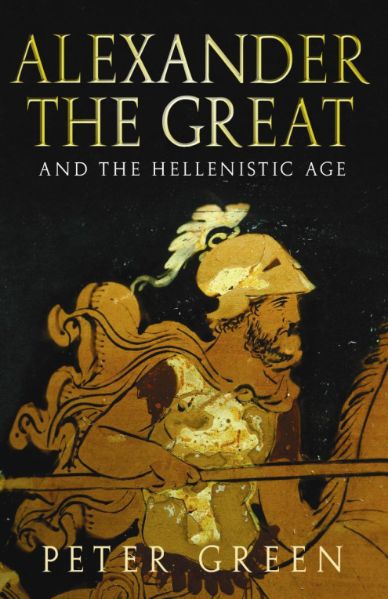
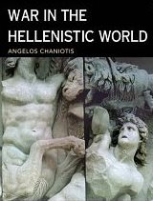
Alexander the Great and the Hellenistic World
Greatest Legacy →establish Hellenistic Culture and the spread of the Greek ideals/ideas throughout the known world!!
336 BCE to 146 BCE is known as the HELLENISTIC AGE
Breakup of Alexander’s Empire
family was murdered
“one-world” vision was divided
fierce power struggle ensued

Slide 3
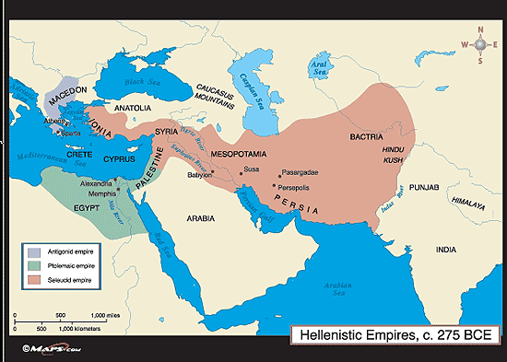
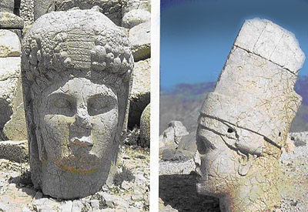
Alexander the Great and the Hellenistic World
Greece divided into Seleucid (Asia), Antigonid (Greece), and Ptolemaic (Egypt) empires
fighting continues and Rome conquers all of it by 100 BCE
Hellenistic Culture Spread Throughout the Mediterranean Region
Alexander had brought Greek culture to the Nile, Middle East, and India
Continuing influence by Greek ideas and vice versa ←→

Slide 4
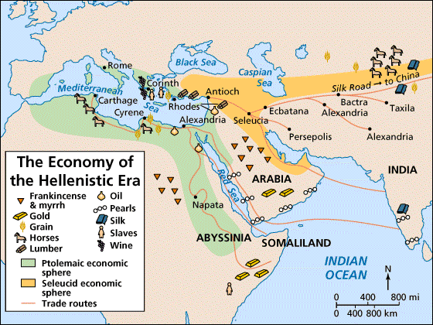
Alexander the Great and the Hellenistic World
The Economy
the aristocracy still owned most of the land
large disparity between wealthy & poor
growing middle class because of the many trade opportunities
trade centered around three main areas on the trade routes
Alexandria, Egypt
Island of Rhodes (off coast of Asia Minor)
Antioch in Syria
routes connected the Med. World to India

Slide 5
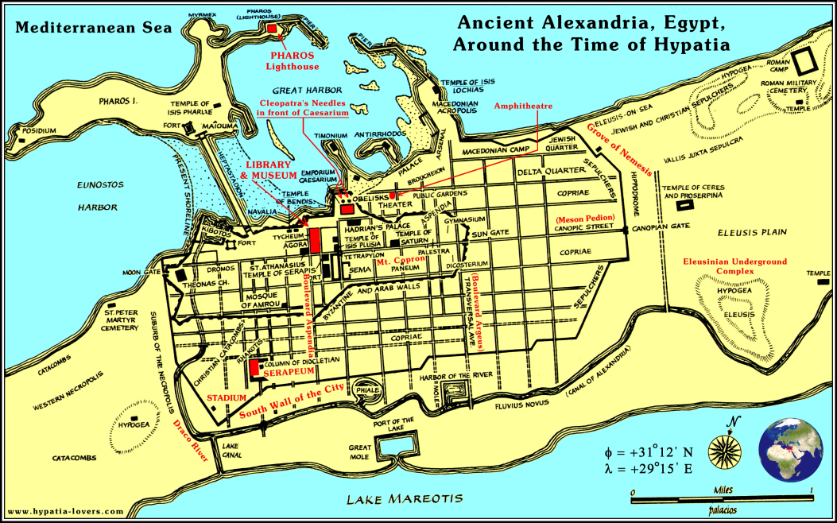
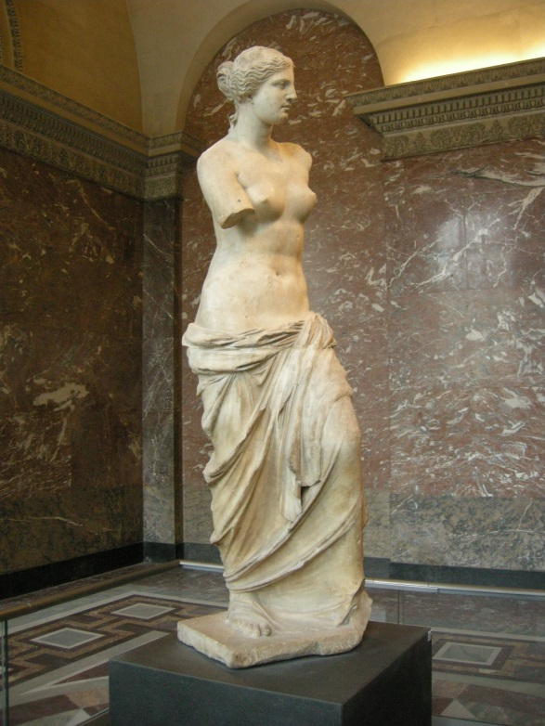
Alexander the Great and the Hellenistic World
cities rebuilt or well-planned and laid-out
incl. marketplaces & large public buildings (theaters, schools, gymnasiums)
Alexandria had pop. of over 1 million
library had over 750,000 papyrus scrolls and became a center of learning & commerce
women became more respected
gained rights - own property
right to divorce husband
seen more in public

Slide 6
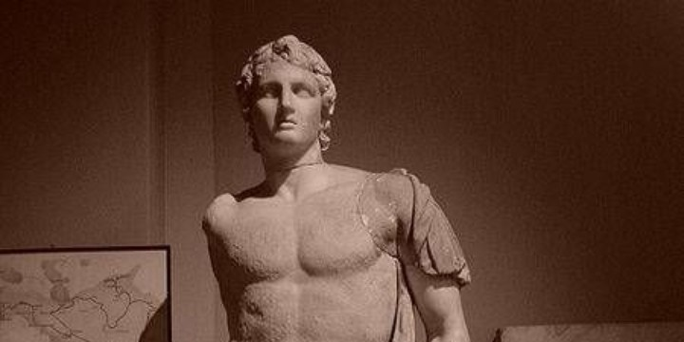
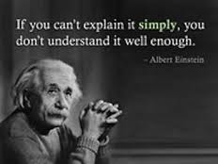
Alexander the Great and the Hellenistic World
New definition of Greek
all Hellenized people were now considered Greek
more of the world became Greek & considered “Greek”
Hellenistic Philosophy
Four new schools developed - more concerned with ethics and behavior than with reality and human existence
- Skeptics - denied the possibility of finding the truth

Slide 7
Alexander the Great and the Hellenistic World
wise people do not judge others or become dogmatic
we rely on sensory experience as the only source of human knowledge
sensory experience is unreliable
nobody truly knows anything
Detach from the world!!
Cynics - even more negative
ideal was nonattachment to society and its values
taught that people should seek virtue only and scorn pleasure, wealth, and social prestige
nature provided all human needs

Slide 8
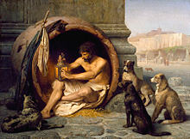
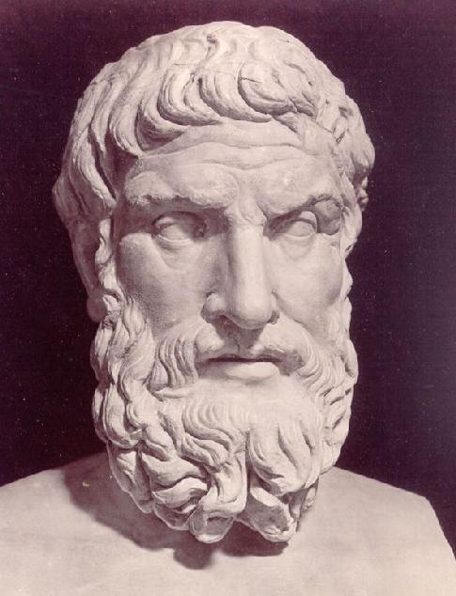
Alexander the Great and the Hellenistic World
Diogenes- best known Cynic
“Look at me, I am without house or city, property or slave. I sleep on the ground. I have no wife, no children. What do I lack? Am I not without distress or fear?...
Am I not free?”
Epicureans - Epicurus
happiness could be achieved by freeing the body from pain and mind from fear
to reach goal, people must avoid bodily excesses - including sensual pleasures

Slide 9
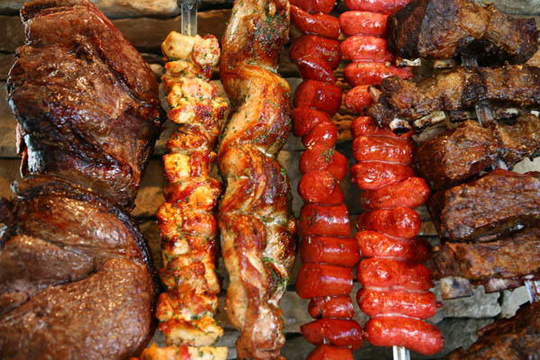
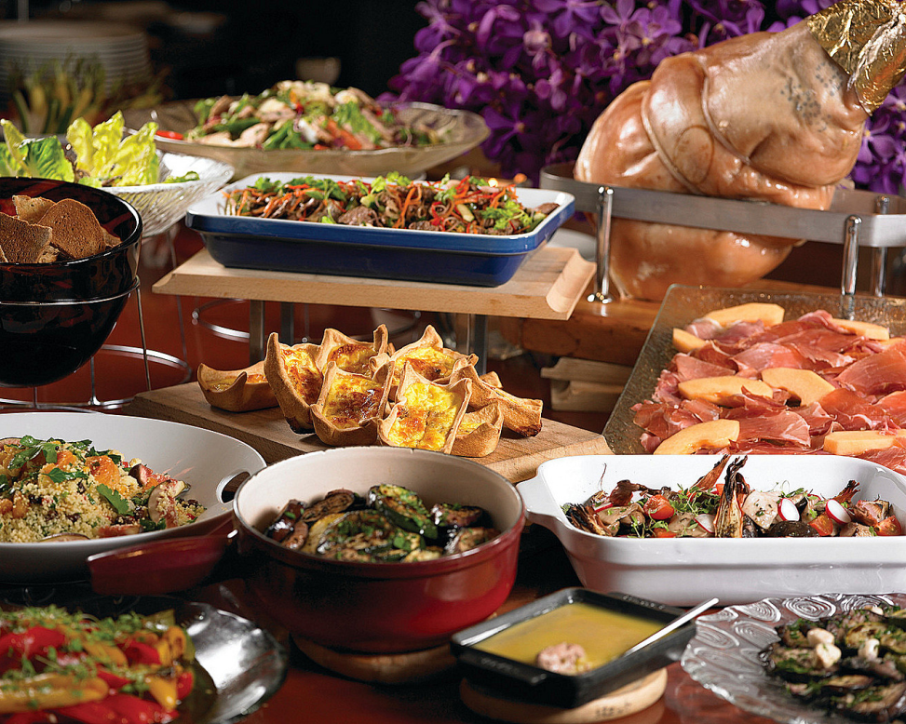
Alexander the Great and the Hellenistic World
there is no existence beyond death, so there is nothing to fear about death
finest pleasures are intellectual – not physical
if gods exist, they do not concern themselves with humans
after Epicurus’ death, his followers began to seek physical pleasure
“Eat, drink and be merry, for tomorrow may bring pain or death.”

Slide 10
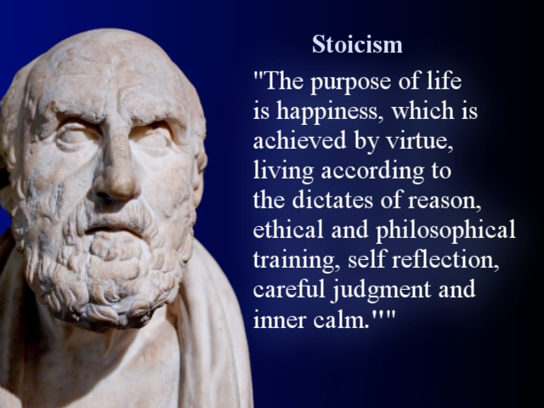
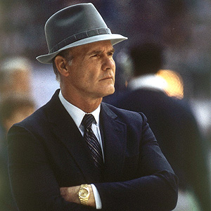
Alexander the Great and the Hellenistic World
Stoics - estab. by Zeno
argued that the universe was controlled by some power - Reason, World Soul, Fortune, God
determines everything and there is nothing humans can do about it
whatever fate dictated was right
people should accept whatever nature might bring and not complain
should become indifferent to pain, fear, pleasure, grief
believed in equality and duty
greatly influenced the Romans and Christian thinking
- today means someone outwardly not affected by pain or pleasure

Slide 11
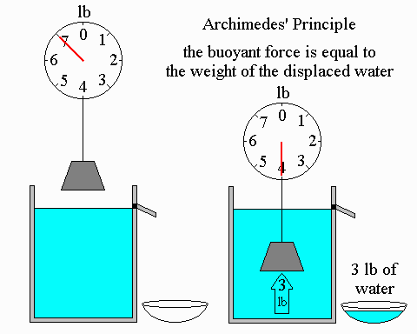
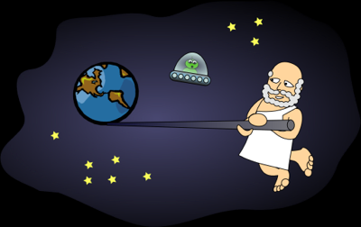
Alexander the Great and the Hellenistic World
Science and Math
Archimedes - determined formula for circumference of a circle
explained the principle of the lever
discovered the theory of specific gravity (measuring volume)
body in liquid is held up by a force equal to the weight of liquid displaced
Aristarchus – heliocentric
Ptolemy – geocentric
Eratosthenes - calculated diameter of earth to within 50 miles

Slide 12
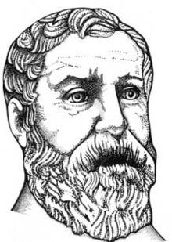
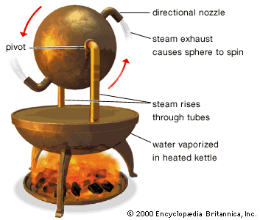
Alexander the Great and the Hellenistic World
Two characteristics of Hellenistic Science
scientists learned much with simple instruments
- no telescopes, microscopes, compasses, etc.
2. made little effort to apply knowledge in practical way
valued knowledge for the sake of knowledge
did not want to make money from knowledge
eg., Hero of Alexandria invented a steam engine but it was regarded only as an interesting toy
slavery served as a basis of Hellenistic civilization and labor-saving devices were not needed to help the slaves

