Slide 1
The Enlightenment
“The Age of Reason”

Slide 2
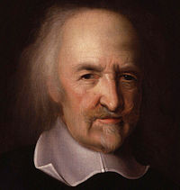
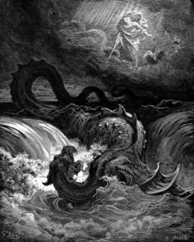
Thomas Hobbes
Humans are naturally wicked & selfish
Gov’t is needed to keep order
Social Contract
People hand their right over to a strong ruler → gain law & order
Ruler needs total power to keep citizens under control
Once the people enter into contract with the gov’t; they couldn’t rebel.
Wrote Leviathan (1651)
that great Leviathan called a Commonwealth or State which is but an Artificial Man; though of greater stature and strength than the Natural, for whose protection and defense it was intended; and in which, the Sovereignty is an Artificial Soul, as giving life and motion to the whole body ..

Slide 3
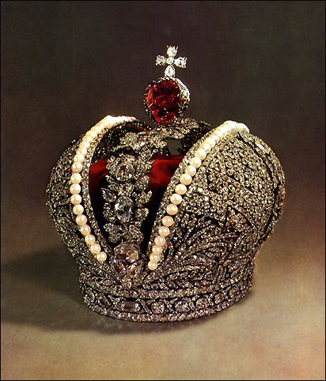
Foundation of Power
Old Idea
Monarch’s rule is justified by divine right
New Idea
Government’s power comes from the consent of the governed.

Slide 4
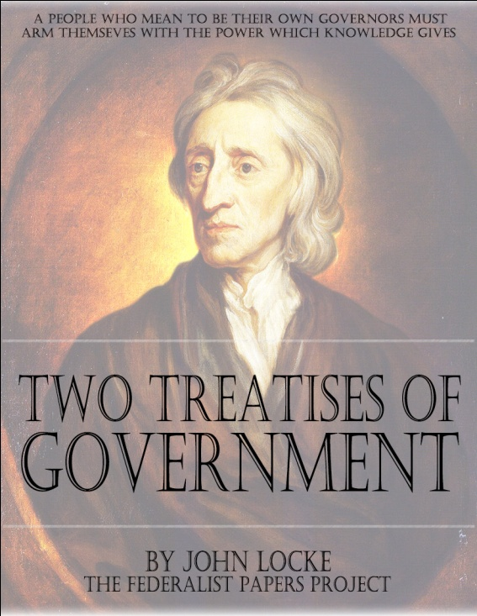
John Locke
More positive view of human nature Tabula Rasa – “blank slate”
People are formed by their experiences
Purpose of gov’t was to create order in society
Three Natural Rights (born with)
Life
Liberty
Property
Gov’t’s power comes from the consent of the people
Therefore:
people had the right to rebel if the gov’t broke the contract

Slide 5
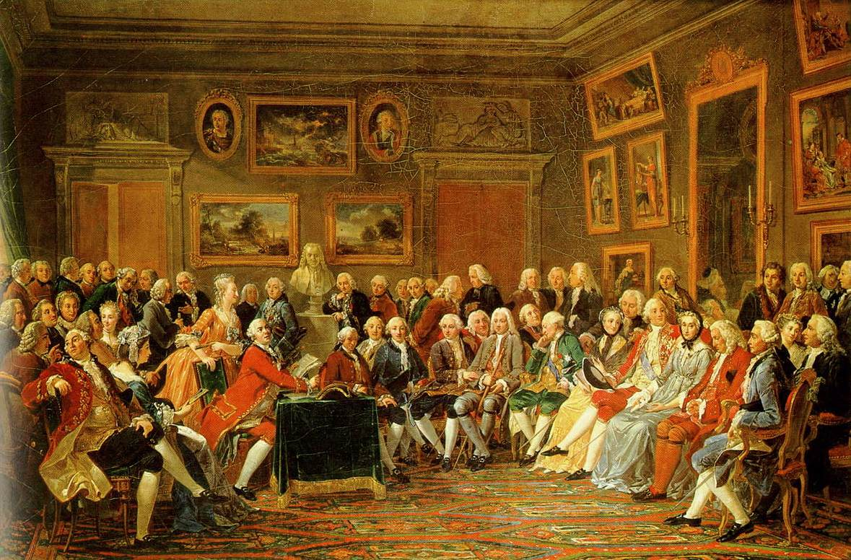
Philosophes
French word for philosopher
Mid – 1700’s, France became a meeting place for people to discuss politics and ideas
5 Core beliefs of the Philosophes:
Reason – truth is discovered through reason
Nature – what was natural was good & reasonable
Happiness – happiness could be found on Earth
Progress – society could improve
Liberty – call for freedoms

Slide 6
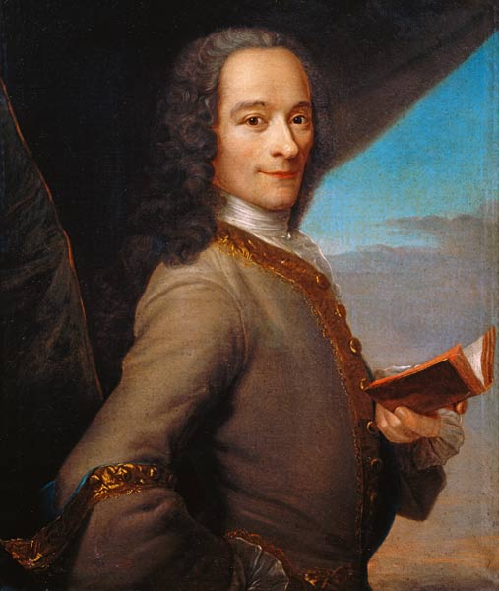
Voltaire (Francois Marie Arouet)
Most influential of the Philosophes
Used satire (sarcasm) in his writings
Made many enemies b/c of his sharp tongue
Believed an enlightened despot would help reform society – admired England
Emphasized freedom of thought and relative freedom of speech
Believed in religious liberty – criticized intolerance & social usefulness of religion
Condemned the established church – clergy bred intolerance, bigotry, and superstition
Praised the cultural advancements of Louis XIV
“I do not agree with a word you say but will defend to the death your right to say it.”

Slide 7
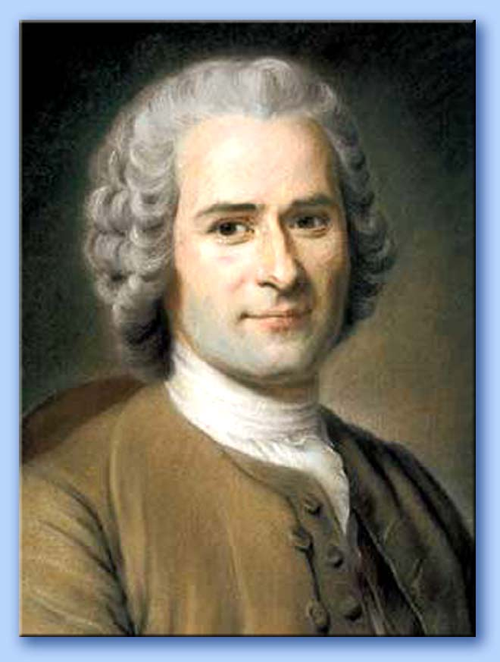
Jean Jacques Rousseau
Man is good; society corrupts man
Man is a “noble savage”
Social Contract (1762)
Agreement between free individuals to create a society and a gov’t
Individual surrender natural liberty to each other
Individual wills combine into a General Will.
People give up some freedoms for the common good.
Direct Democracy was the ideal government
All people are equal

Slide 8
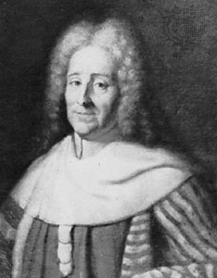
Baron de Montesquieu
Spirit of Laws (1748)
Separation of powers within gov’t – Checks and Balances
Believed that England was the best example of this
Type of law was related to the local conditions
Republics – small states
Despotism – large states
Monarchies - moderate size

Slide 9
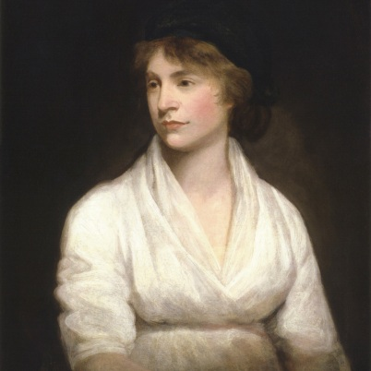
Mary Wollstonecraft
18th century English writer
A Vindication of the Rights of Women (1792)
Pioneer of women’s rights
Considered a founding philosopher for the feminist movement.
Her daughter was Mary Shelly - Frankenstein
Argued that women were NOT inferior to men
Lack of education
Women and men should be treated as rational beings in a society of reason.

