Slide 1
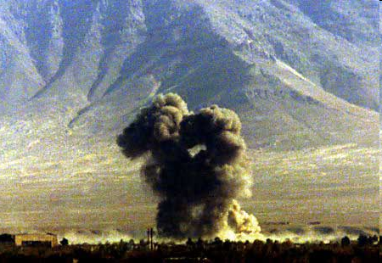
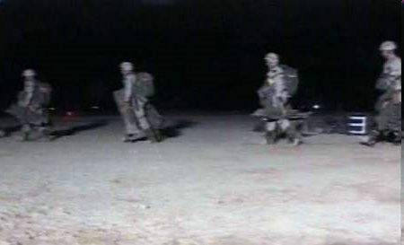
Operation Enduring Freedom
Oct 19 – After almost 2 weeks of aerial bombardments, US Army Rangers launch raids into Afghanistan from Pakistan
Oct 20 – 2 US soldiers die in a helicopter crash – 1st military casualties of the war
Oct 24 – Patriot Act passes House and is signed into law by Bush on Oct 26

Slide 2
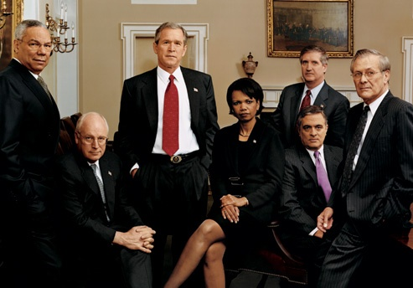
The Bush War Team
Bush increases pressure on world to participate in the Global War on Terror (GWOT)
“A coalition partner must do more than just express sympathy, a coalition partner must perform. That means different things for different nations. Some nations don’t want to contribute troops and we understand that. Other nations can contribute intelligence-sharing. ... But all nations, if they want to fight terror, must do something…Over time it’s going to be important for nations to know they will be held accountable for inactivity. You’re either with us or against us in the fight against terror.”
- George W. Bush, November 6, 2001

Slide 3
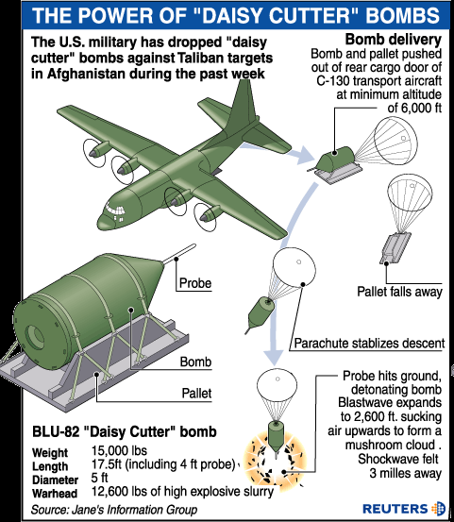
Operation Enduring Freedom
Nov 9 – After heavy bombardment and US support, Northern Alliance capture major city of Mazar-e-Sharif
Strategy is to allow Northern Alliance to win war against Taliban with US and Coalition support
Nov 13 – Taliban leave Kabul; US begins speeding formation of new government
Too much? Proportional?

Slide 4
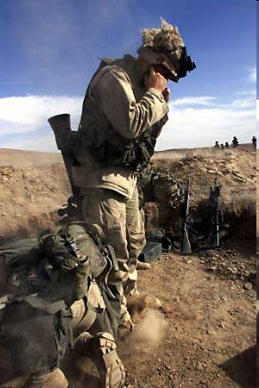
Operation Enduring Freedom
Nov 25 – Americans land hundreds of marines around the southern city of Kandahar – last stronghold of the Taliban
Focused efforts to capture bin Laden on the Tora Bora section of the rugged mountains of southern Afghanistan
makes first public comment regarding Saddam Hussein in the Global War on Terror – “Saddam is evil. I think he's got weapons of mass destruction, and I think he needs to open up his country to let us inspect.”

Slide 5
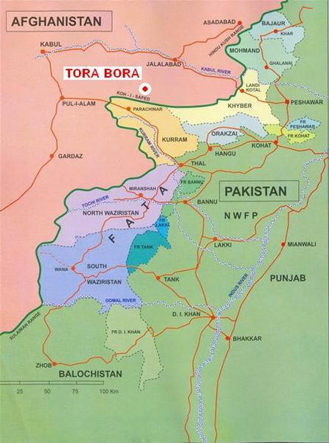
Operation Enduring Freedom
Dec 7 – last stronghold of Taliban, Kandahar, falls; conflicting reports of Mullah Omar – captured, escaped, released?; Hamid Karzai named interim leader of government; US continues bombing of Tora Bora
- US issues ultimatum to al-Qaeda fighters in Tora Bora; continue bombings

Slide 6
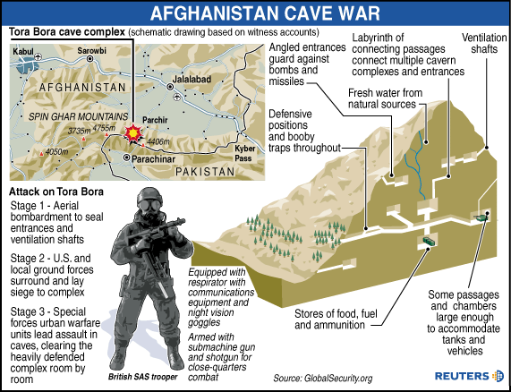
Operation Enduring Freedom
Mid-December – Northern Alliance troops enter Tora Bora; find more than 200 al-Qaeda fighters dead and 35 fighters surrender; no Osama bin Laden or Ayman al-Zawahiri
- Later reports confirm bin Laden escaped to Pakistan primarily due to lack of US troop presence – only 100 US soldiers in Tora Bora to block escape

Slide 7
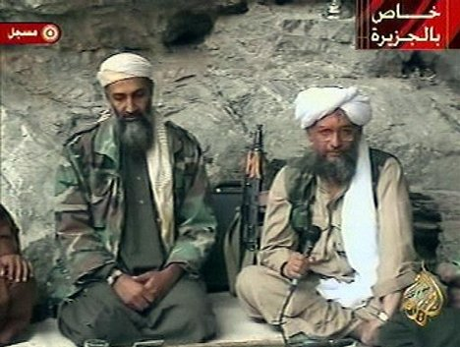
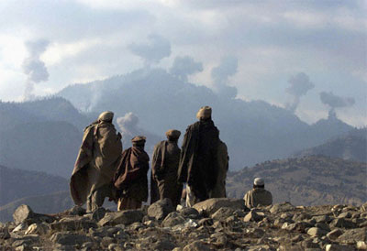
Operation Enduring Freedom
Mullah Omar also escapes Kandahar
bin Laden, al-Zawahiri, and Mullah Omar are all still at large (bin Laden killed May 2, 2011)
believed bin Laden paid locals to help him escape
recent history of Pakistan affected by these men – helped with resurgence of Taliban in Pakistan
- By the end of the year, military acknowledges bin Laden’s escape but Administration says he is on the run and is powerless

Slide 8
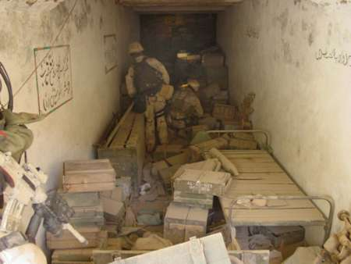
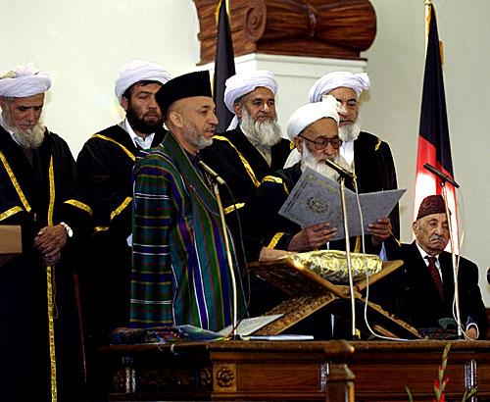
Operation Enduring Freedom
hunt for bin Laden continues into 2002 and beyond (ended May, 2011)
reconstruction of Afghanistan begins
cost of war in Afghanistan, including reconstruction – over $444 billion; total cost could exceed $1.8 trillion by 2021(Congressional Research Service estimate as of March, 2011)
- national elections held in Oct, 2004 – Hamid Karzai elected with 55% of the vote – sworn in despite claims of voter fraud

Slide 9
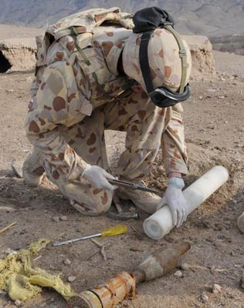
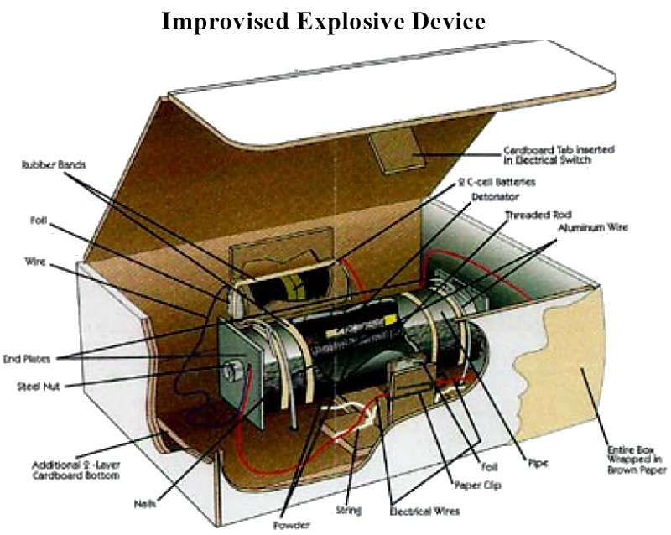
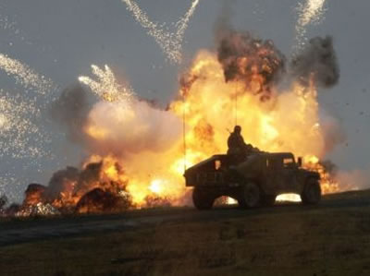
Operation Enduring Freedom -2002 and beyond
three-fold effort in Afghanistan
find and capture Osama bin Laden
root out Taliban resistance and neutralize
stabilize and rebuild government structures to bring normality to Afghanis
Taliban flees to mountains to re-organize
fight asymmetric war – IEDs, suicide bombing, limited engagement, disrupt civilian life, etc.
- attention of US after 2003 turns to Iraq!

Slide 10
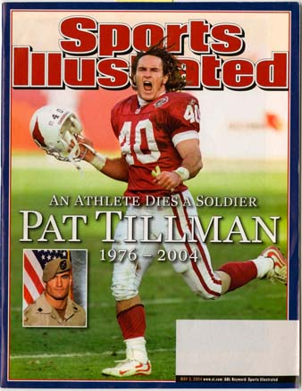
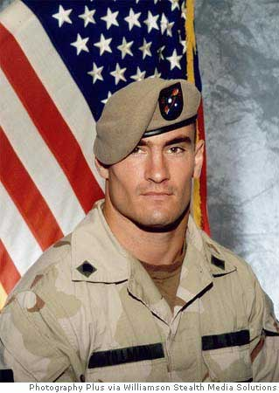
The Story of Pat Tillman
Football star for Arizona Cardinals
- gave up $3.6 million contract to enlist after 9/11
becomes most famous victim of friendly-fire of the war
controversy surrounds death and aftermath
Was this a violation of the ethics of war?

Slide 11
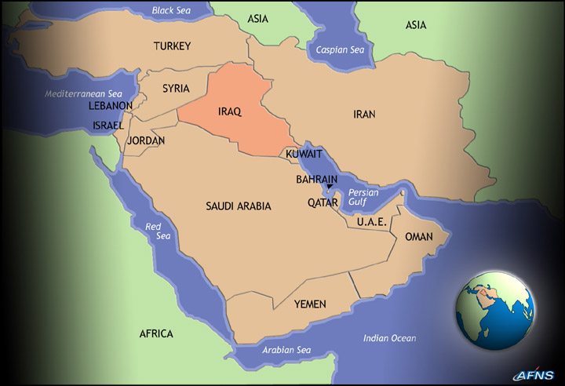
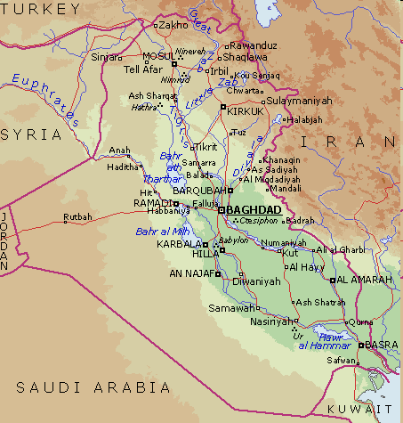
And now let’s talk about Iraq (finally!)
History (because this is a history class)
- long, proud history – remember Mesopotamia from 9th grade?
controlled by Ottoman Empire until end of World War I
Great Britain and US interested in Iraq for its oil
finally given its independence in 1932, but greatly influenced (interfered) by GB & US

Slide 12
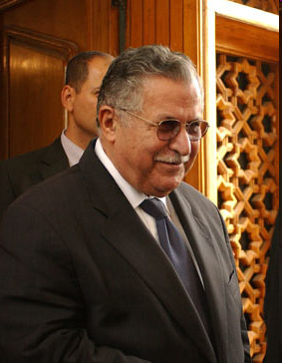
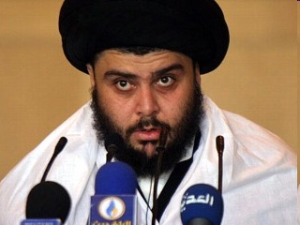
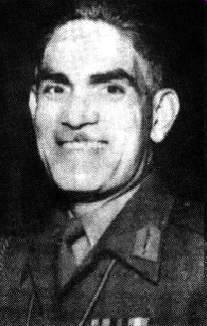
History of Iraq
Three major groups
Kurds – ~15%
Sunni Arabs - ~30%
Shi’a Arabs - ~50%
rest are minorities
independence brought a monarchy
Jalal Talabani, President of Iraq, Kurdish politician
Moqtada al-Sadr, influential religious and political leader, Shi’a
monarchy ended after coup d’état in 1958
Abd al-Karim Qasim ruled as Prime Minister; favored friendly relations w/ Soviet Union – brings him into conflict w/ US & G. Britain
Abd al- Karim Qasim, Sunni

Slide 13
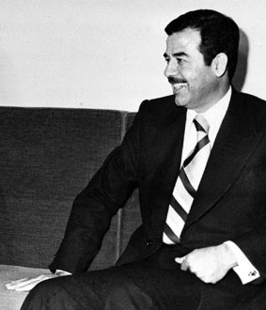
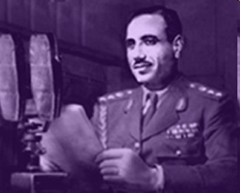
History of Iraq
- March, 1959 – Qasim withdraws from Baghdad Pact (NATO-like alliance)
October – with support of CIA, Ba’athist Party attempts coup – failed
78 tried for treason
Abd al-Salam Arif – condemned but later pardoned by Qasim
- Another conspirator, also condemned, escaped to Syria and later Egypt
Saddam Hussein

Slide 14
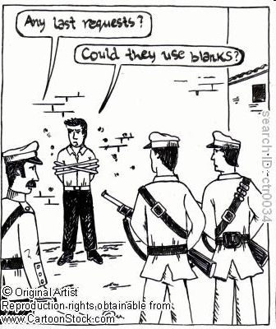
History of Iraq
In the “no good deed goes unpunished” category →
- Qasim is overthrown by Arif on Oct. 8, 1963; executed on Oct. 9
Saddam returns to Iraq but is imprisoned the next year
Arif killed in helicopter crash in 1966; brother takes over but he is overthrown in 1968
Saddam escapes prison in 1967 and becomes major Ba’athist politician – begins unification
helps Ahmad Hassan al-Bakr to power in 1968 coup and becomes second in command of Iraq

Slide 15
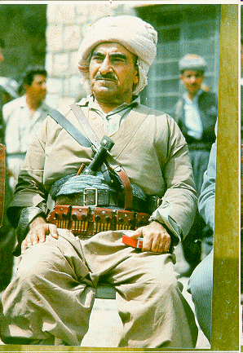
History of Iraq
meanwhile Kuwait gains independence in 1961; Iraq claims sovereignty over Kuwait → causes foreign policy difficulties
Kurds in northern Iraq push for autonomy; 1961 – 1970 → civil war; Kurds win autonomy but tensions remain
tensions also exist with Iran over border
US supportive of Saddam’s rise to power because he is viewed as a strong anti- communist
Mustafa Barzani, legendary Kurdish leader, 1903-1979

Slide 16
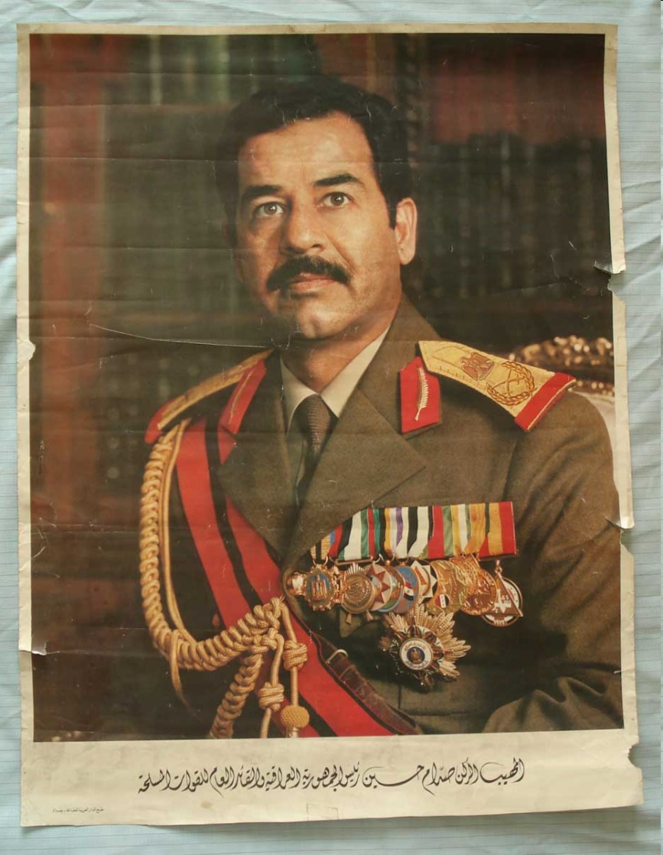
Saddam Hussein
begins consolidating power in Ba’ath Party and in government; gains control of many prominent administrative agencies
with many factions (Sunni v. Shi’a, Arab v. Kurd), Saddam institutes modernization programs & strong oppressive tactics to control coups → understands Iraq’s recent history
by early 70s, Saddam is essentially leader of Iraq, but al-Bakr is still President
at Saddam’s direction, he nationalizes oil company in 1972; Iraq becomes wealthy as oil prices skyrocket in 1973
Saddam Hussein, propaganda poster, cult of personality

Slide 17
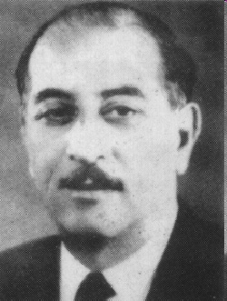
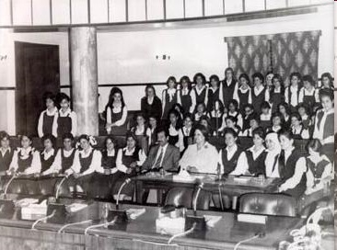
Saddam Hussein
Saddam becomes President on July 16, 1979, citing the failing health of al-Bakr (his health really fails in 1982 when he dies from food poisoning; hmmm….)
by following WEEK, hundreds of Ba’ath Party officials accused of treason and executed; firing squads composed of surviving Party officials
imposes western-style legal system and bans Shari’a courts; promotes women’s rights
courts Soviet Union but later reneges on agreement
Ahmad Hassan al-Bakr

Slide 18
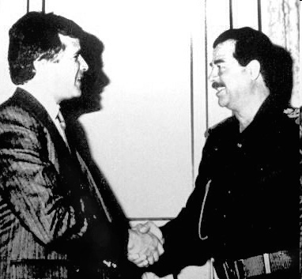
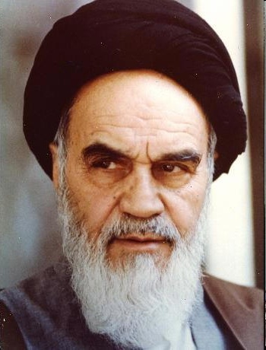
Saddam Hussein
by end of year, Saddam firmly in place as dictator
Iranian Revolution → impetus to more hostile rhetoric between nations → Saddam intensely dislikes Ayatollah Khomeini b/c Khomeini incited Shi’as to overthrow him in 1975
Saddam meeting with Chilean businessman as a world leader
Disputes over borders and Shatt-al-Arab waterway → access to Persian Gulf
invades Iran in September, 1980 claiming Iraq had been attacked

Slide 19
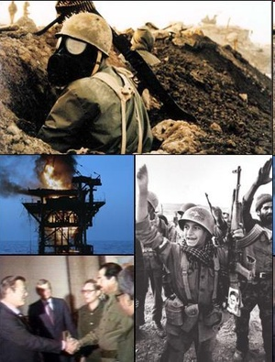
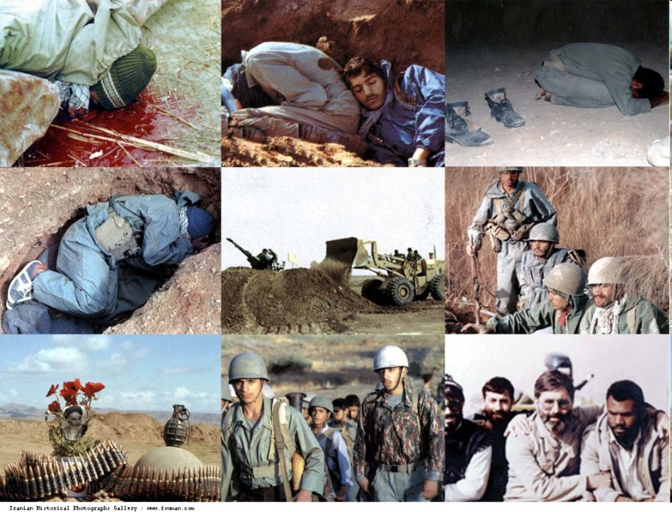
Iran-Iraq War
with the support of the Arab states, the United States, the Soviet Union, and Europe, and heavily financed by the Arab states of the Persian Gulf, Saddam Hussein had become “the defender of the Arab world” against a revolutionary Iran
brutal, bloody war with huge casualties on both sides
chemicals weapons used
major suppliers of arms to Iran→ North Korea & US!! (Iran-Contra Scandal – ask me about it)

Slide 20
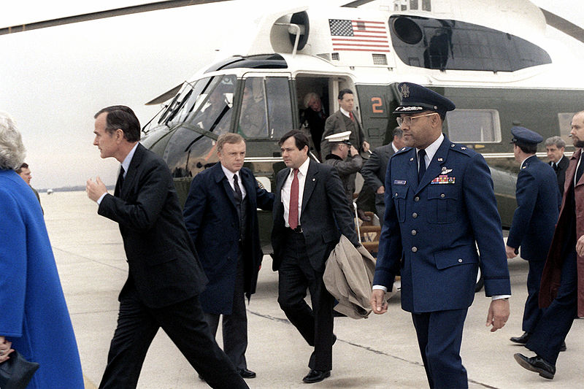
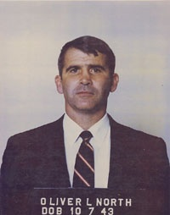
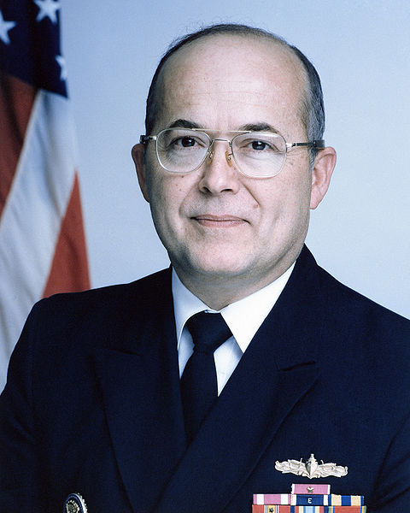
Iran-Contra Scandal
Iran takes American hostages in 1979 -> so Iran is bad & we have no diplomatic ties with them
but they will need weapons to fight Iraq
meanwhile the US is helping the Contra rebels in Nicaragua fight the communist Sandinistas government – they need money but we are not suppose to help
Reagan administration creates a special office to sell weapons to Iran through Israel to fund the rebels in Nicaragua
Oliver North John Poindexter
- several Reagan administration officials found guilty of illegal arms sales, perjury, and obstruction of justice – none served jail time; most pardoned and later worked in Bush White House

Slide 21
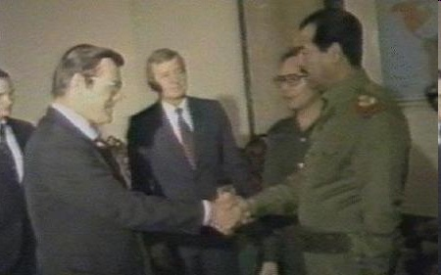
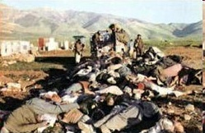
Iran-Iraq War
US also helping Iraq – picture to left shows Donald Rumsfeld (Senior Advisor to President Reagan and Special Envoy to Middle East) meeting with Saddam in 1983
Gas attack at Halabja, est. 5000 killed
est. 1 million Iranians killed
est. 500,000 Iraqis killed
total cost was about $600 billion each
Iraq is left with huge debt to many nations and finds it needs revenues b/c oil production has been severely disrupted

Slide 22
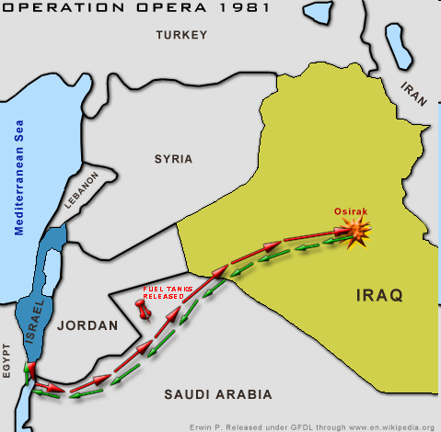
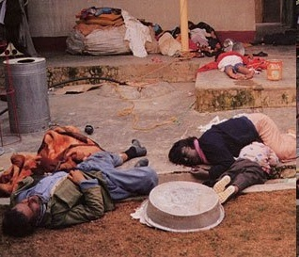
Other things happening in Iraq during war
US and other western powers give aid to Saddam through the 70s
1981 – Israel uses airstrike to destroy a nuclear reactor believed to be making fissionable materials
- Saddam oppresses Kurds –uses chemical weapons – kills up to 182,000 and destroys many villages in 1982

Slide 23
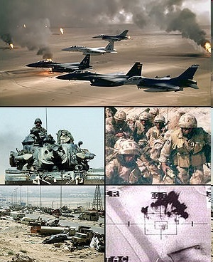
Operation Desert Storm
Iraq tries to raise price of oil by limiting production – Kuwait opposes move in OPEC
Kuwait refuses to forgive Iraqi debt
Saddam claims Kuwait is pumping Iraq oil
August 2, 1990 Iraq bombs and invades Kuwait – Kuwait is unable to defend itself and falls
- US creates coalition of countries supplying troops or money to expel Saddam from Kuwait; universal international condemnation of Saddam

Slide 24
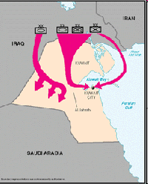
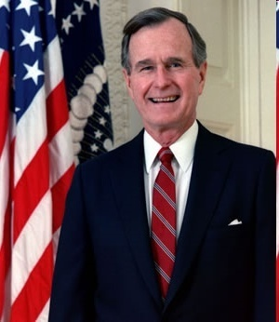
Operation Desert Storm
Jan. 12, 1991 – Congress passes authorization for war against Iraq
many false allegations made to influence Congress
“Within three days, 120,000 Iraqi troops with 850 tanks had poured into Kuwait and moved south to threaten Saudi Arabia. It was then that I decided to act to check that aggression.” – George H.W. Bush, speech in Sept., 1990
satellite photos from this time showed no such build-up
Congress told by woman claiming she was a nurse in Iraqi hospital witnessed babies being pulled from incubators and thrown on floor to die
Amnesty International reported there is no evidence these events ever occurred

