Slide 1
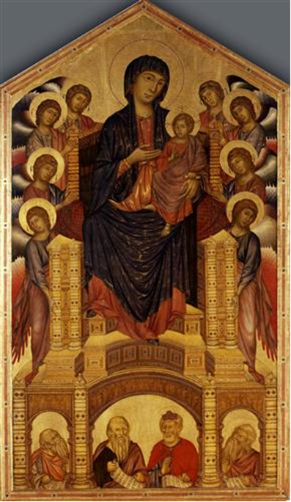
Cimabue
Madonna Enthroned
c. 1280-1290 Tempera on panel
Galleria degli Uffizi, Florence

Slide 2
Raphael.
The Small Cowper Madonna.
c.1505. Oil on wood.
The National Gallery of Art,
Washington DC, USA.

Slide 3
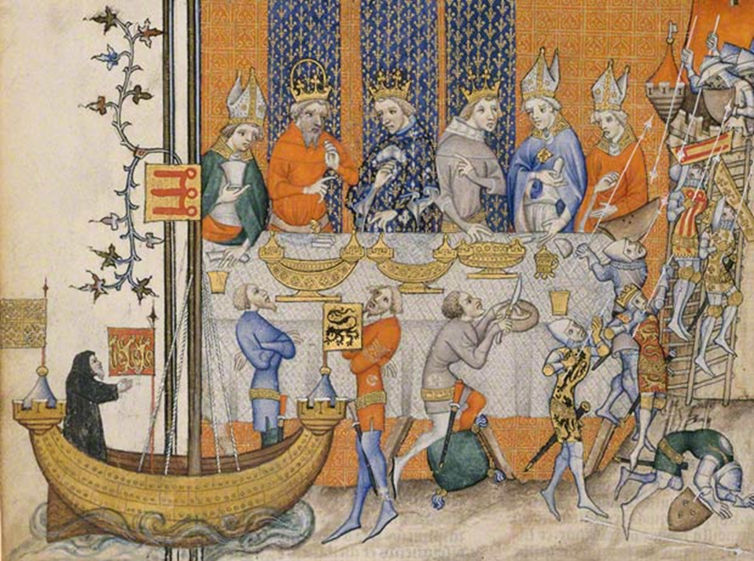
The Performance of a Crusade Play at King Charles V's Feast , 1375–80

Slide 4
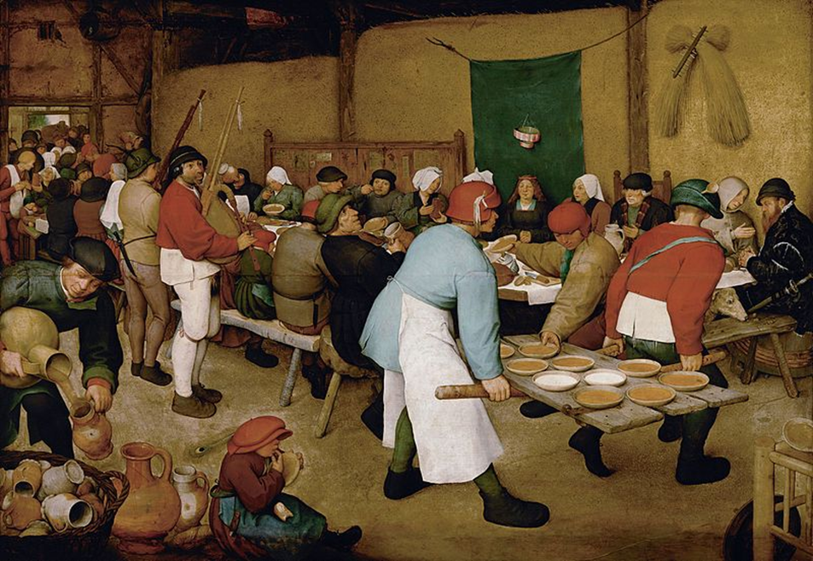
The Peasant Wedding, Pieter Bruegel the Elder, 1567

Slide 5
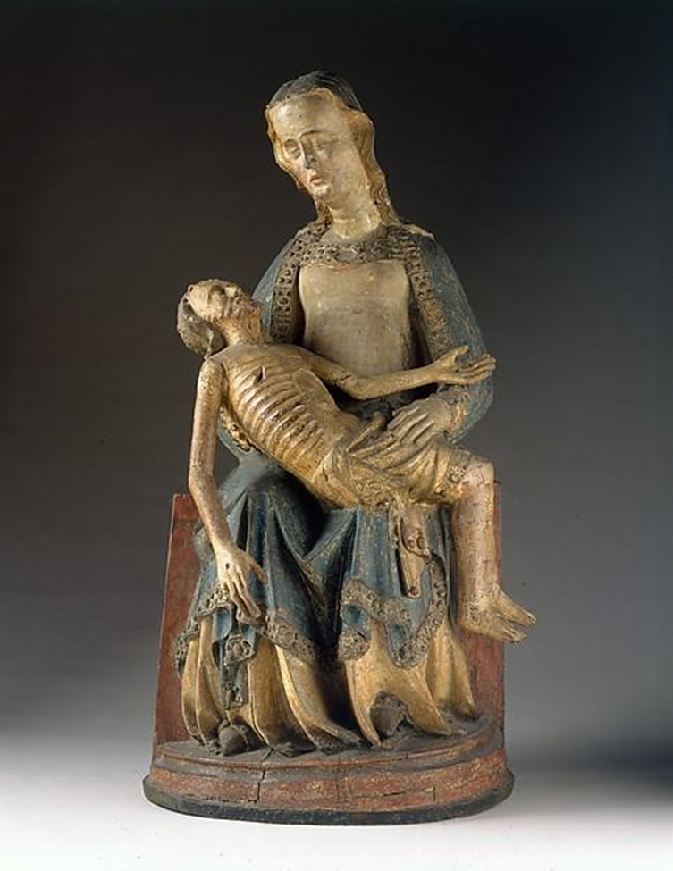
Pietà
c. 1375-1400
The Cloisters, New York

Slide 6
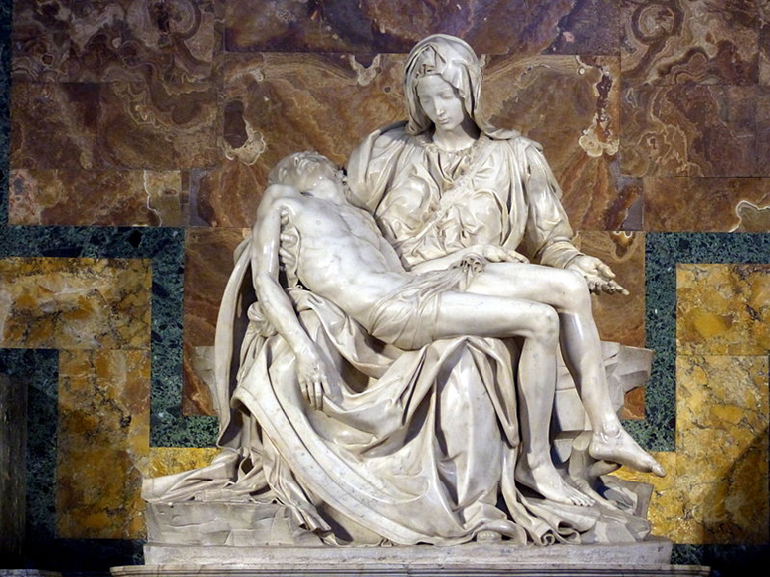
Michelangelo Buonarroti
Pietà
1498-99
St. Peter’s Basilica, Vatican City, Rome, Italy

