Slide 1
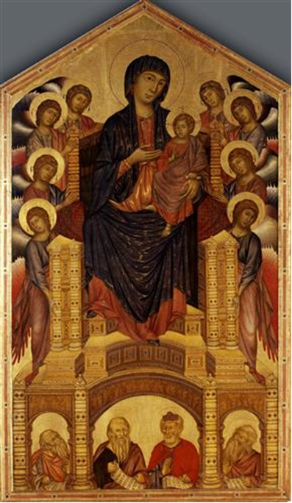
Document 3
Cimabue
Madonna Enthroned
c. 1280-1290 Tempera on panel
Galleria degli Uffizi, Florence

Slide 2
Document 4
Raphael.
The Small Cowper Madonna.
c.1505. Oil on wood.
The National Gallery of Art,
Washington DC, USA.

Slide 3
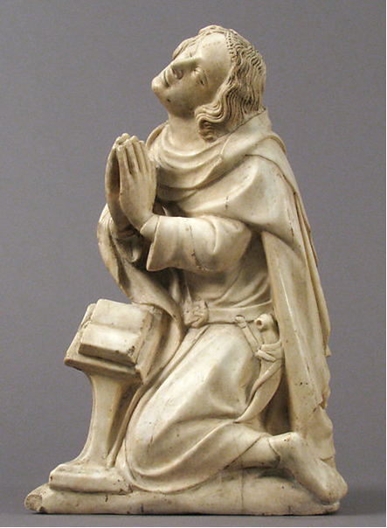
Document 5
Saint Elzéar
ca. 1370–73 Metropolitan Museum of Art, New York

Slide 4
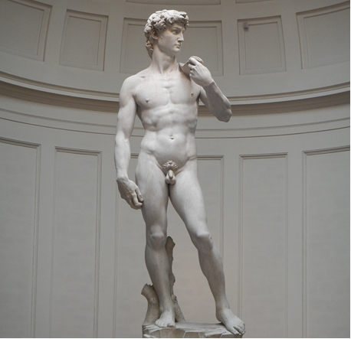
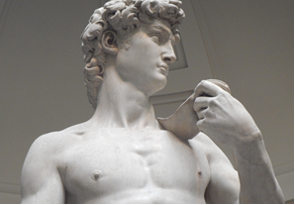
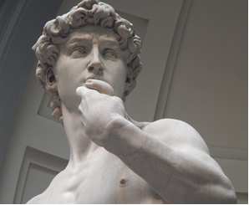
Document 6
Michelangelo Buonarroti
David
1501-04
Academia, Florence, Italy

Slide 5
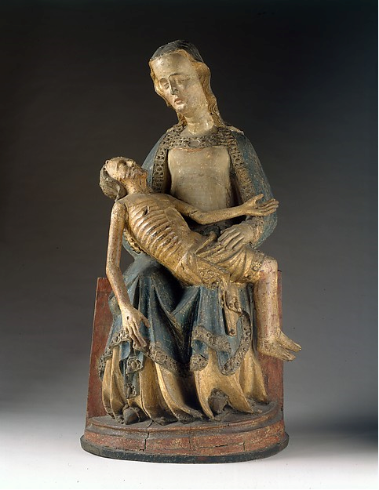
Document 7
Pietà
c. 1375-1400
The Cloisters, New York

Slide 6
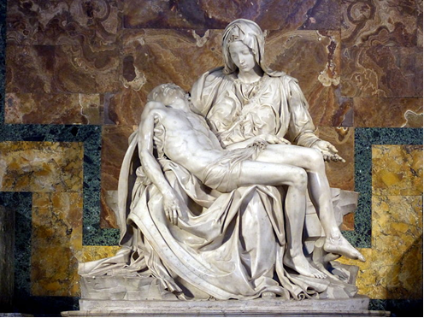
Document 8
Michelangelo Buonarroti
Pietà
1498-99
St. Peter’s Basilica, Vatican City, Rome, Italy

Slide 7
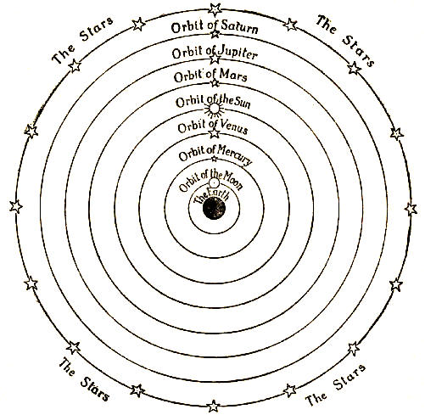
Document 9
Ptolemaic Model of
the Solar System

Slide 8
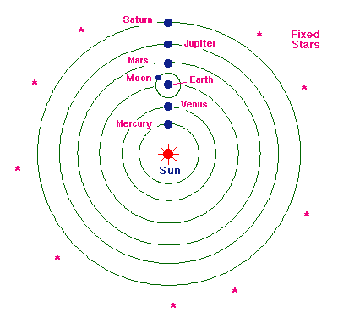
Document 10
Coperican Model of
the Solar System

