Slide 1
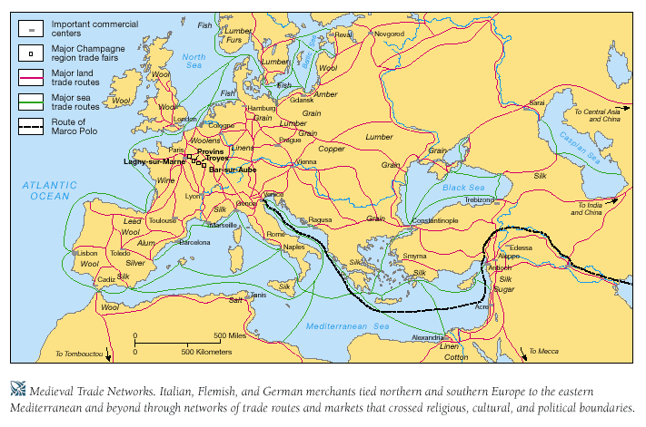
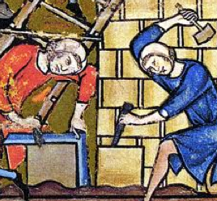
The Renaissance 1300-1600
What’s happening in the world?
Religion is still important → Europe is still CHRISTIAN!
But things are changing
trade is picking up with contact with the east after centuries of war (both internal & external)
rise of guilds & city-states
Trade organizations that regulated prices, wages, quality & quantity of production
recruited, trained and certified apprentices, journeymen, and masters

Slide 2
The Renaissance 1300-1600
What’s happening in the world?
Religion is still important → Europe is still CHRISTIAN!
But things are changing
trade is picking up with contact with the east after centuries of war (both internal & external)
rise of guilds & city-states
Trade organizations that regulated prices, wages, quality & quantity of production
recruited, trained and certified apprentices, journeymen, and masters

Slide 3
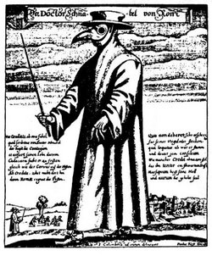
The Renaissance & what’s happening
The Plague → war kills, but disease kills more
25 million died from 1347-1352 (1/3 of the population of Europe)
killed with speed → “…[one] ate lunch with their friends and dinner with their ancestors in paradise…”
what’s good about disease and death?
fewer people, greater demand for their services!
with growing cities, growing power of guilds, and labor shortages, peasants demanded higher wages, access to land, freedom from old labor services (feudalism & manorialism), and real mobility

Slide 4
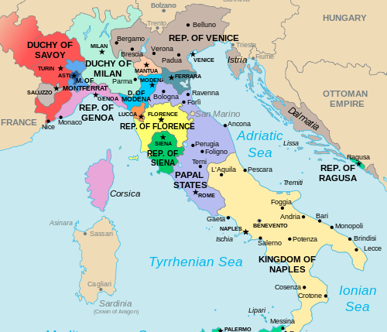
The Renaissance 1300-1600
The growing centers of commerce:
Italy (particularly Florence)
northern Europe – Flanders (northwest France, Belgium, and the Netherlands)
Reassessment of life
Rebellions against the powers failed → new dictatorial govts
new norms
uncertainty over class structures
change in values occurs → new stress on the INDIVIDUAL and the development of Humanism

Slide 5
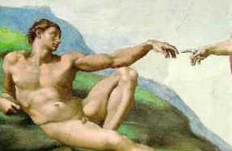
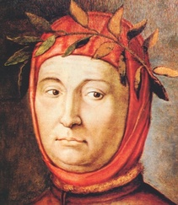
The Renaissance 1300-1600
Humanism - spirit of learning that developed with the revival of classical letters and a renewed confidence in the ability of human beings to determine for themselves truth and falsehood
stress the potential value and goodness of human beings
emphasize common human needs
sought rational ways of solving human problems
moved away from medieval scholasticism
moved towards ancient Greek & Roman thoughts

Slide 6
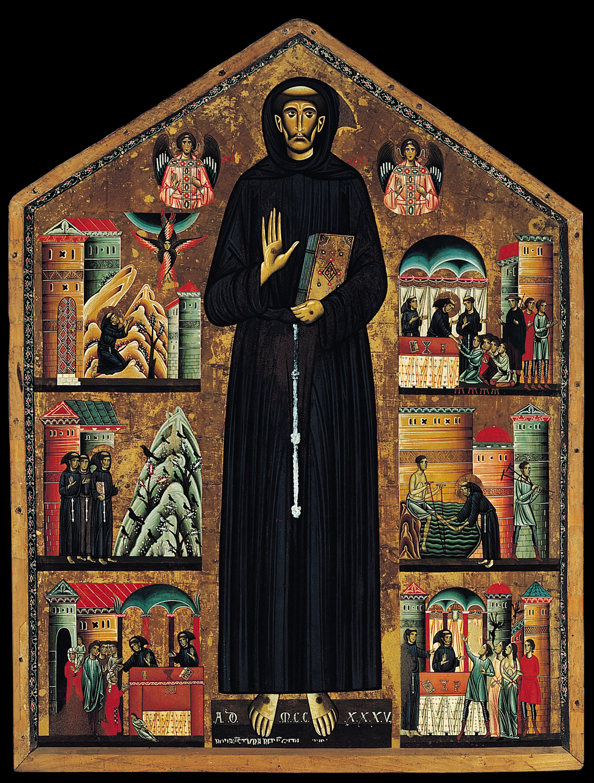
The Renaissance 1300-1600
St. Francis
Berlinghieri
1235

Slide 7
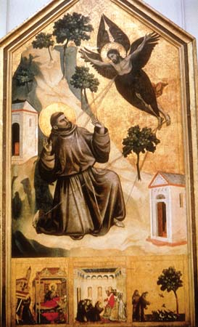
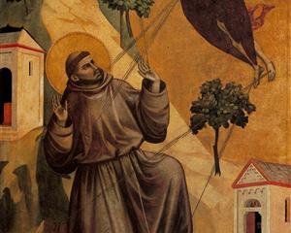
The Renaissance 1300-1600
St. Francis
Giotto
1295

Slide 8
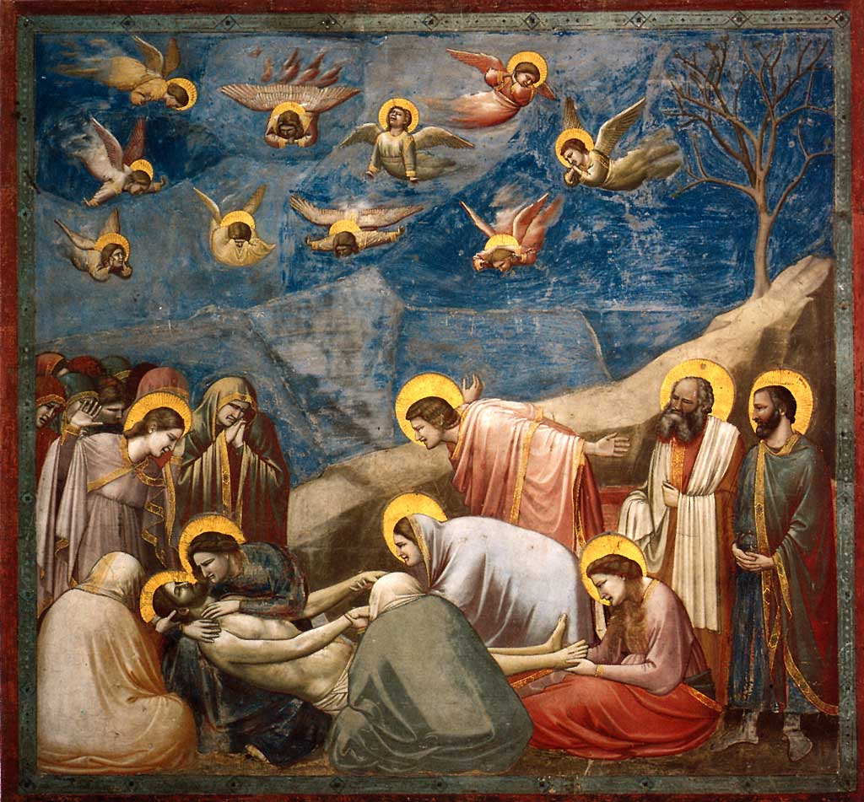
The Renaissance 1300-1600
The Lamentations
Giotto
1305

