Slide 1
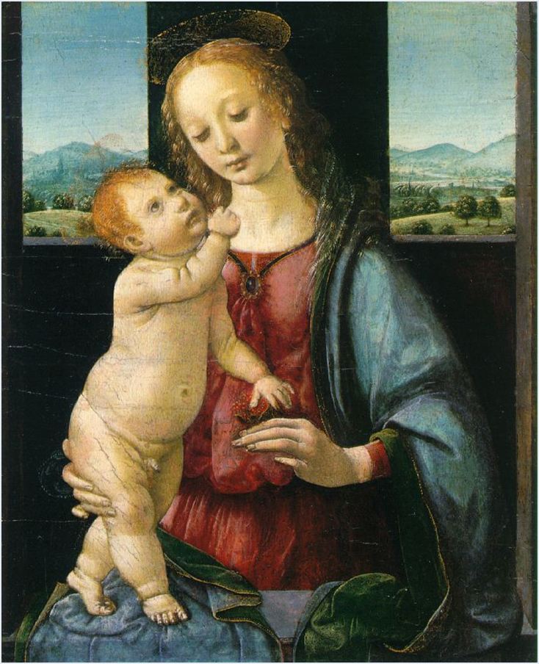
The Renaissance 1300-1600
Geometrical Arrangement of Figures
The Dreyfus Madonna with the Pomegranate
Leonardo da Vinci
1469

Slide 2
The Renaissance 1300-1600
The figure as architecture!!

Slide 3
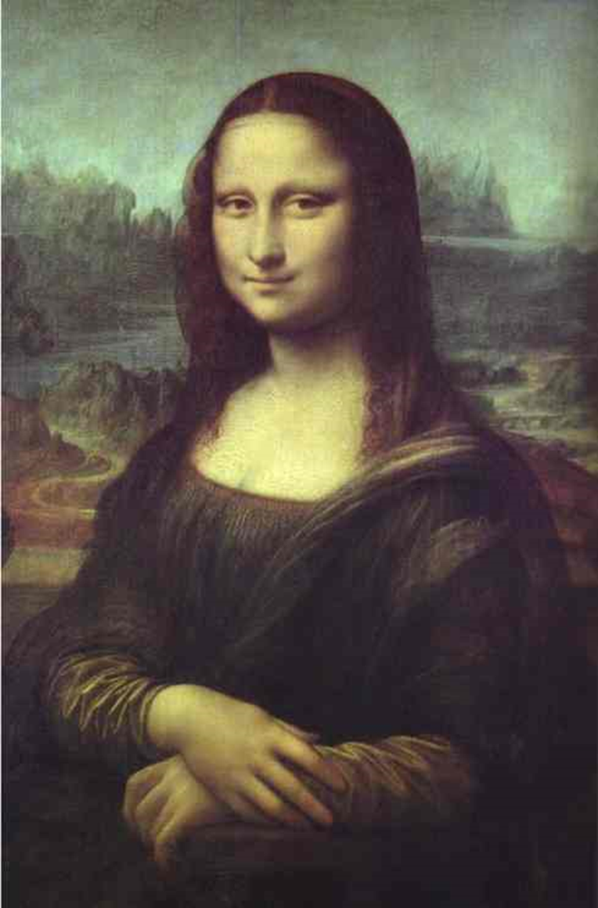
Leonardo da Vinci
Mona Lisa
1503-1506

Slide 4
Sfumato
Chiaroscuro

Slide 5
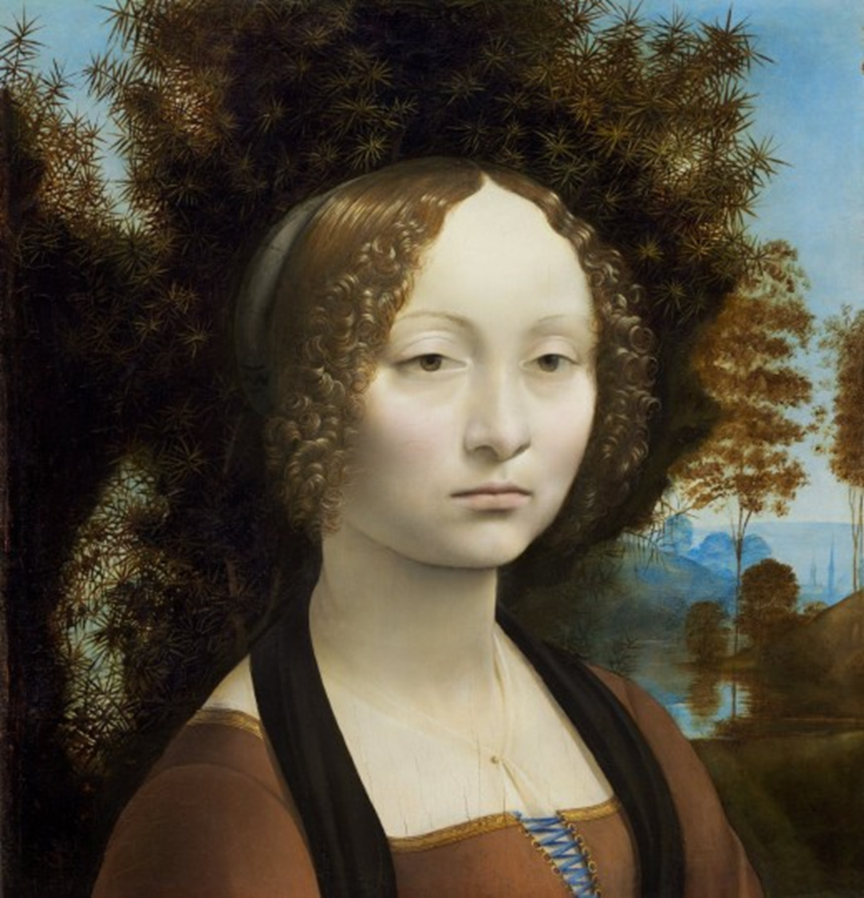
The Renaissance 1300-1600
Ginevra de’ Benci
Leonardo da Vinci
c. 1474/1478

Slide 6
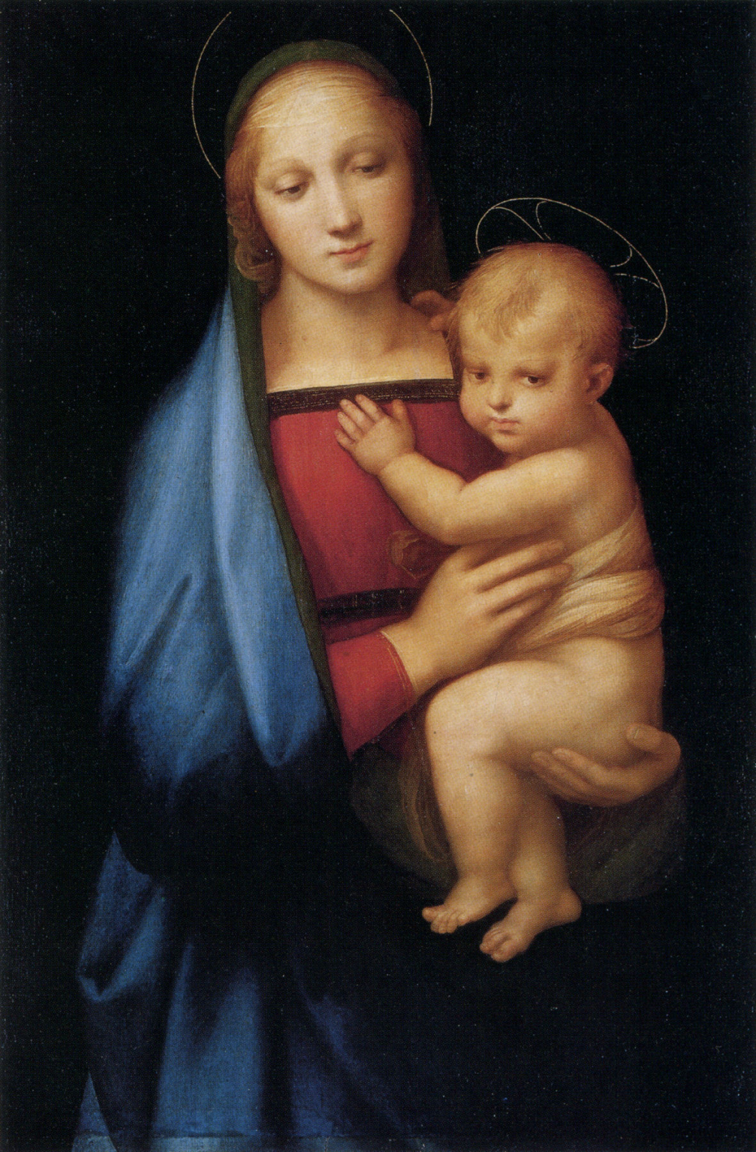
The Renaissance 1300-1600
Raphael
Madonna

