Slide 1
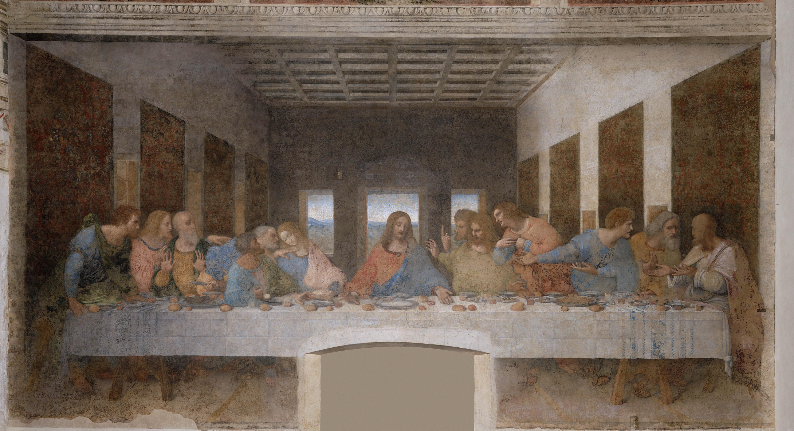
The Renaissance 1300-1600
The Last Supper, Leonardo Da Vinci, 1498

Slide 2
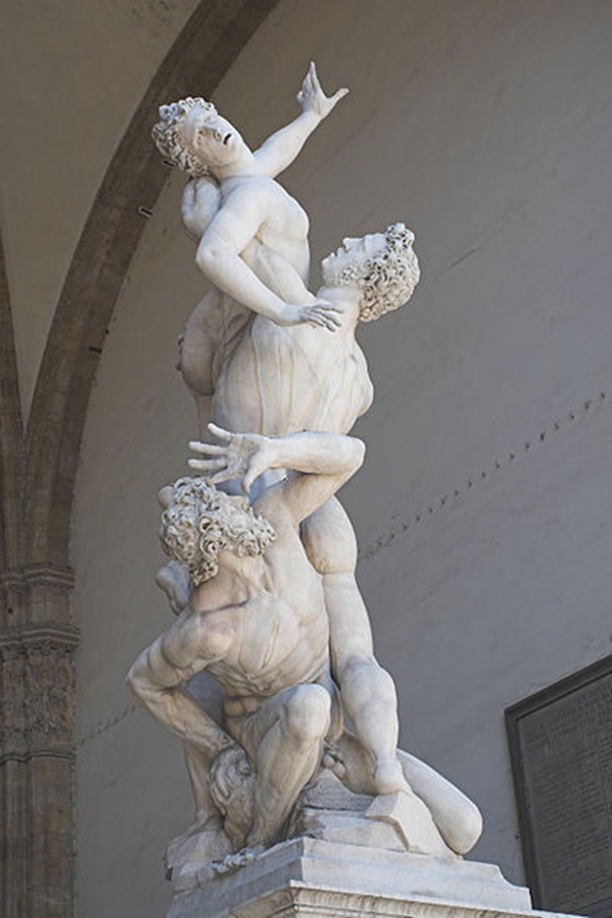
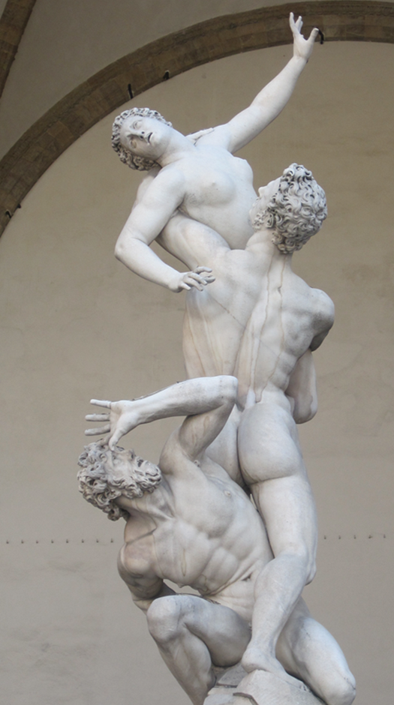
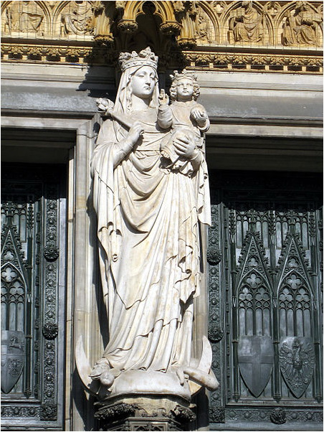

Slide 3
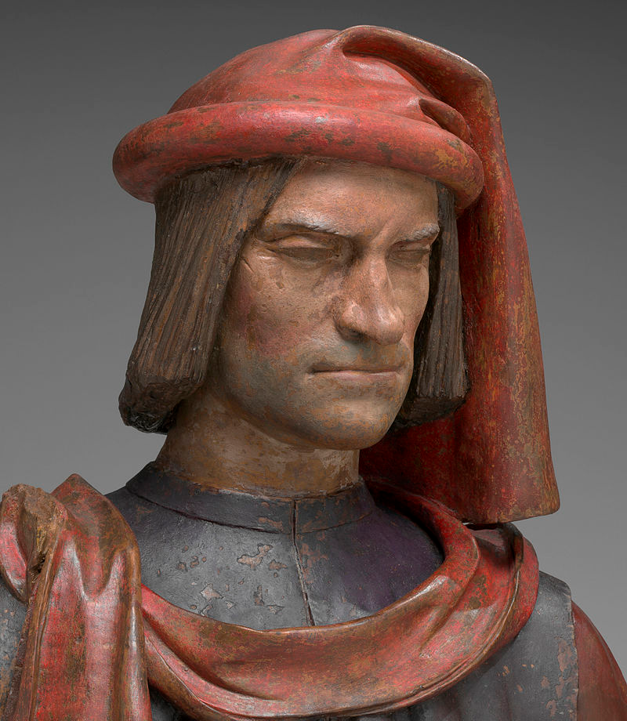
Renaissance
The key people you need to know (besides the artists)
Petrarch, Father of Humanism
William Shakespeare, English playwright
Machiavelli, political philosopher
Lorenzo de Medici, patron, banker, despot

Slide 4
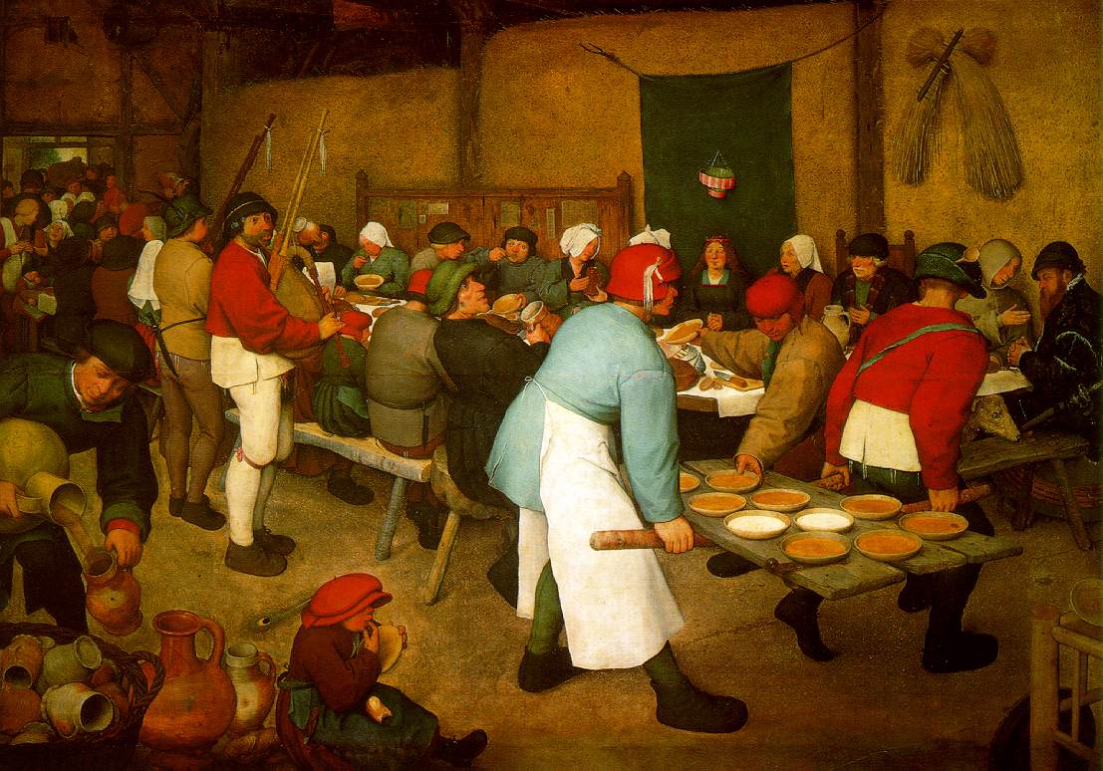
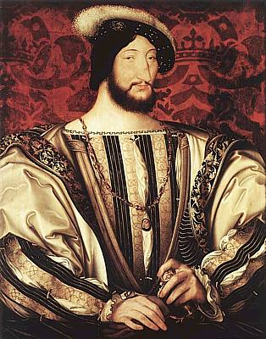
Northern Renaissance
Influenced by Italian Renaissance
Key differences:
Italy was more interested in classical ideas, while No. Europe was more interested in religious reform, return to Christian values, and less influence of church authority
more kings & princes were patrons of art
more realism & naturalism
landscapes
emphasis on middle-class and peasant life
great skill in portraiture

