Slide 1
The Nature of Greek Art
The Greek view of themselves
through architecture, sculpture and pottery

Slide 2
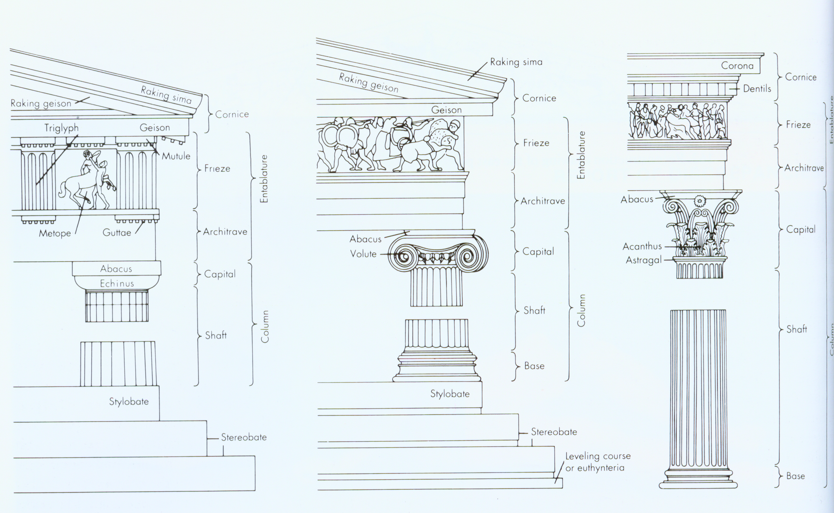
Greek Architectural Orders
Doric Ionic Corinthian

Slide 3
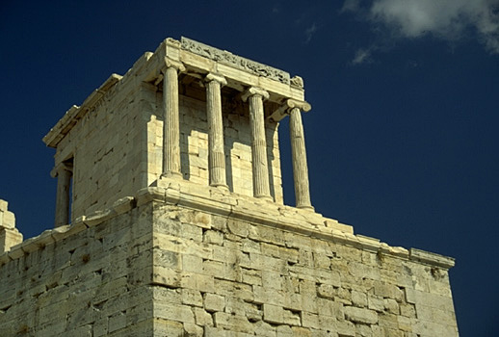

Slide 4
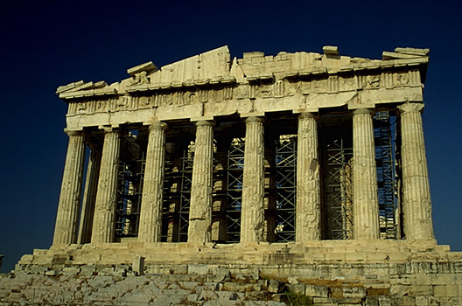
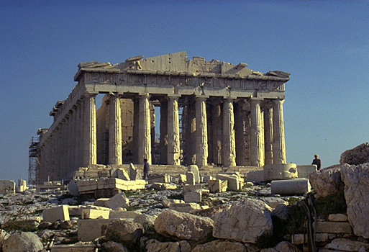

Slide 5
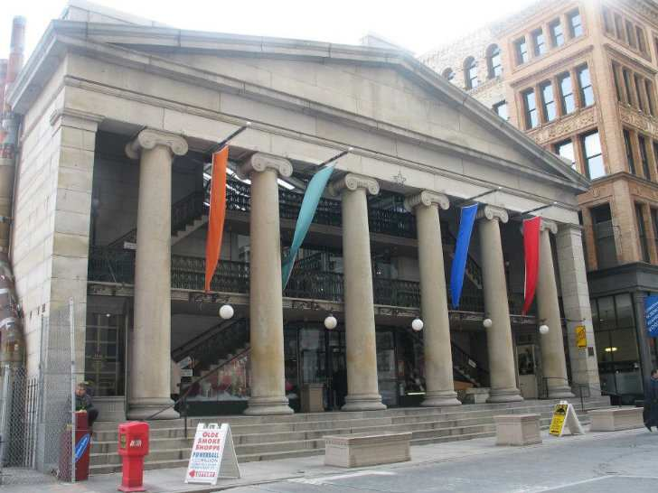

Slide 6
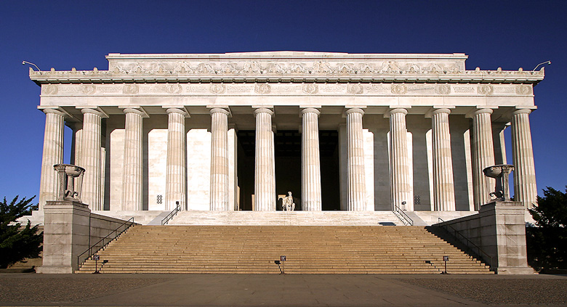
Lincoln Memorial, Washington, D.C.

Slide 7
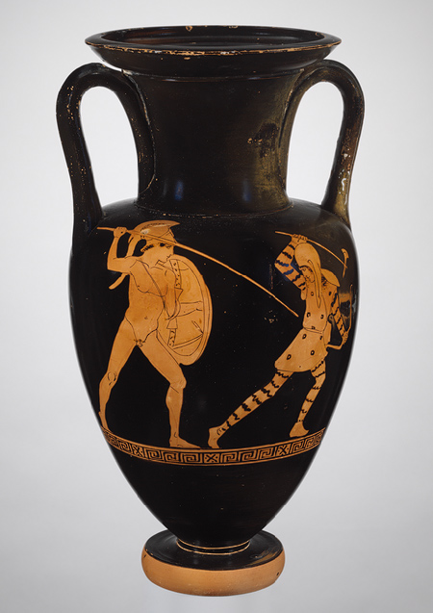
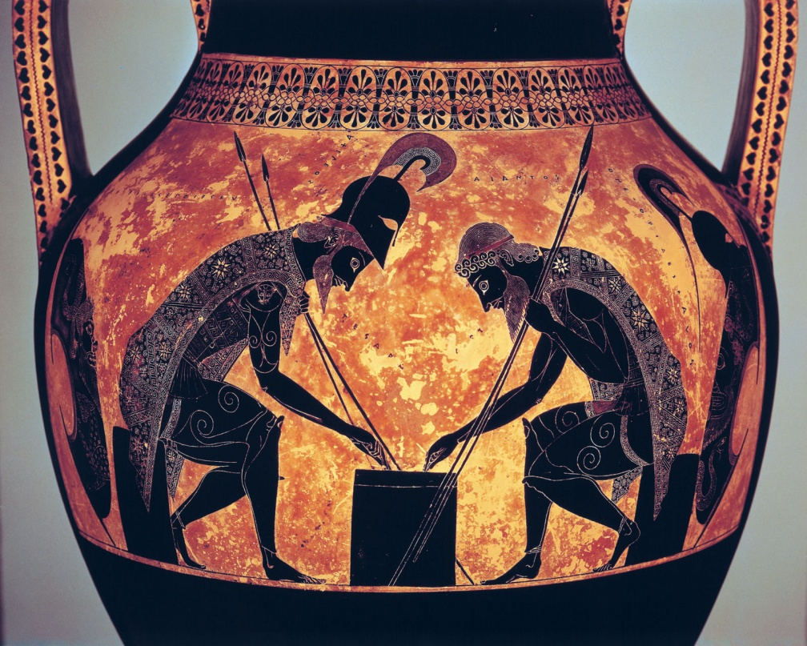
Amphoras
Black-Figured
Vase
Red-Figured
Vase

Slide 9
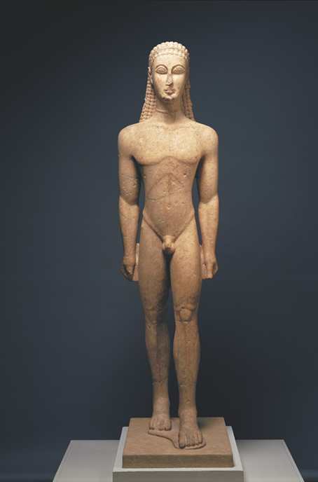

Slide 10
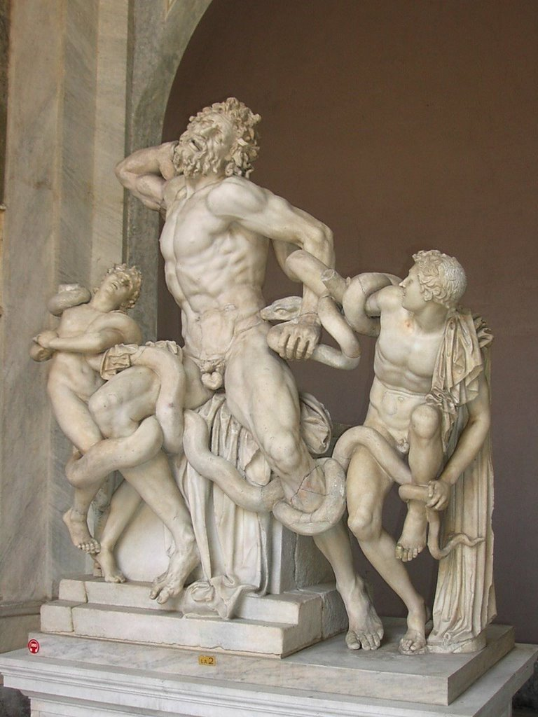
The Laocoön Group
Perhaps by Agesander,
Athenodorus, and
Polydorus of Rhodes

Slide 11
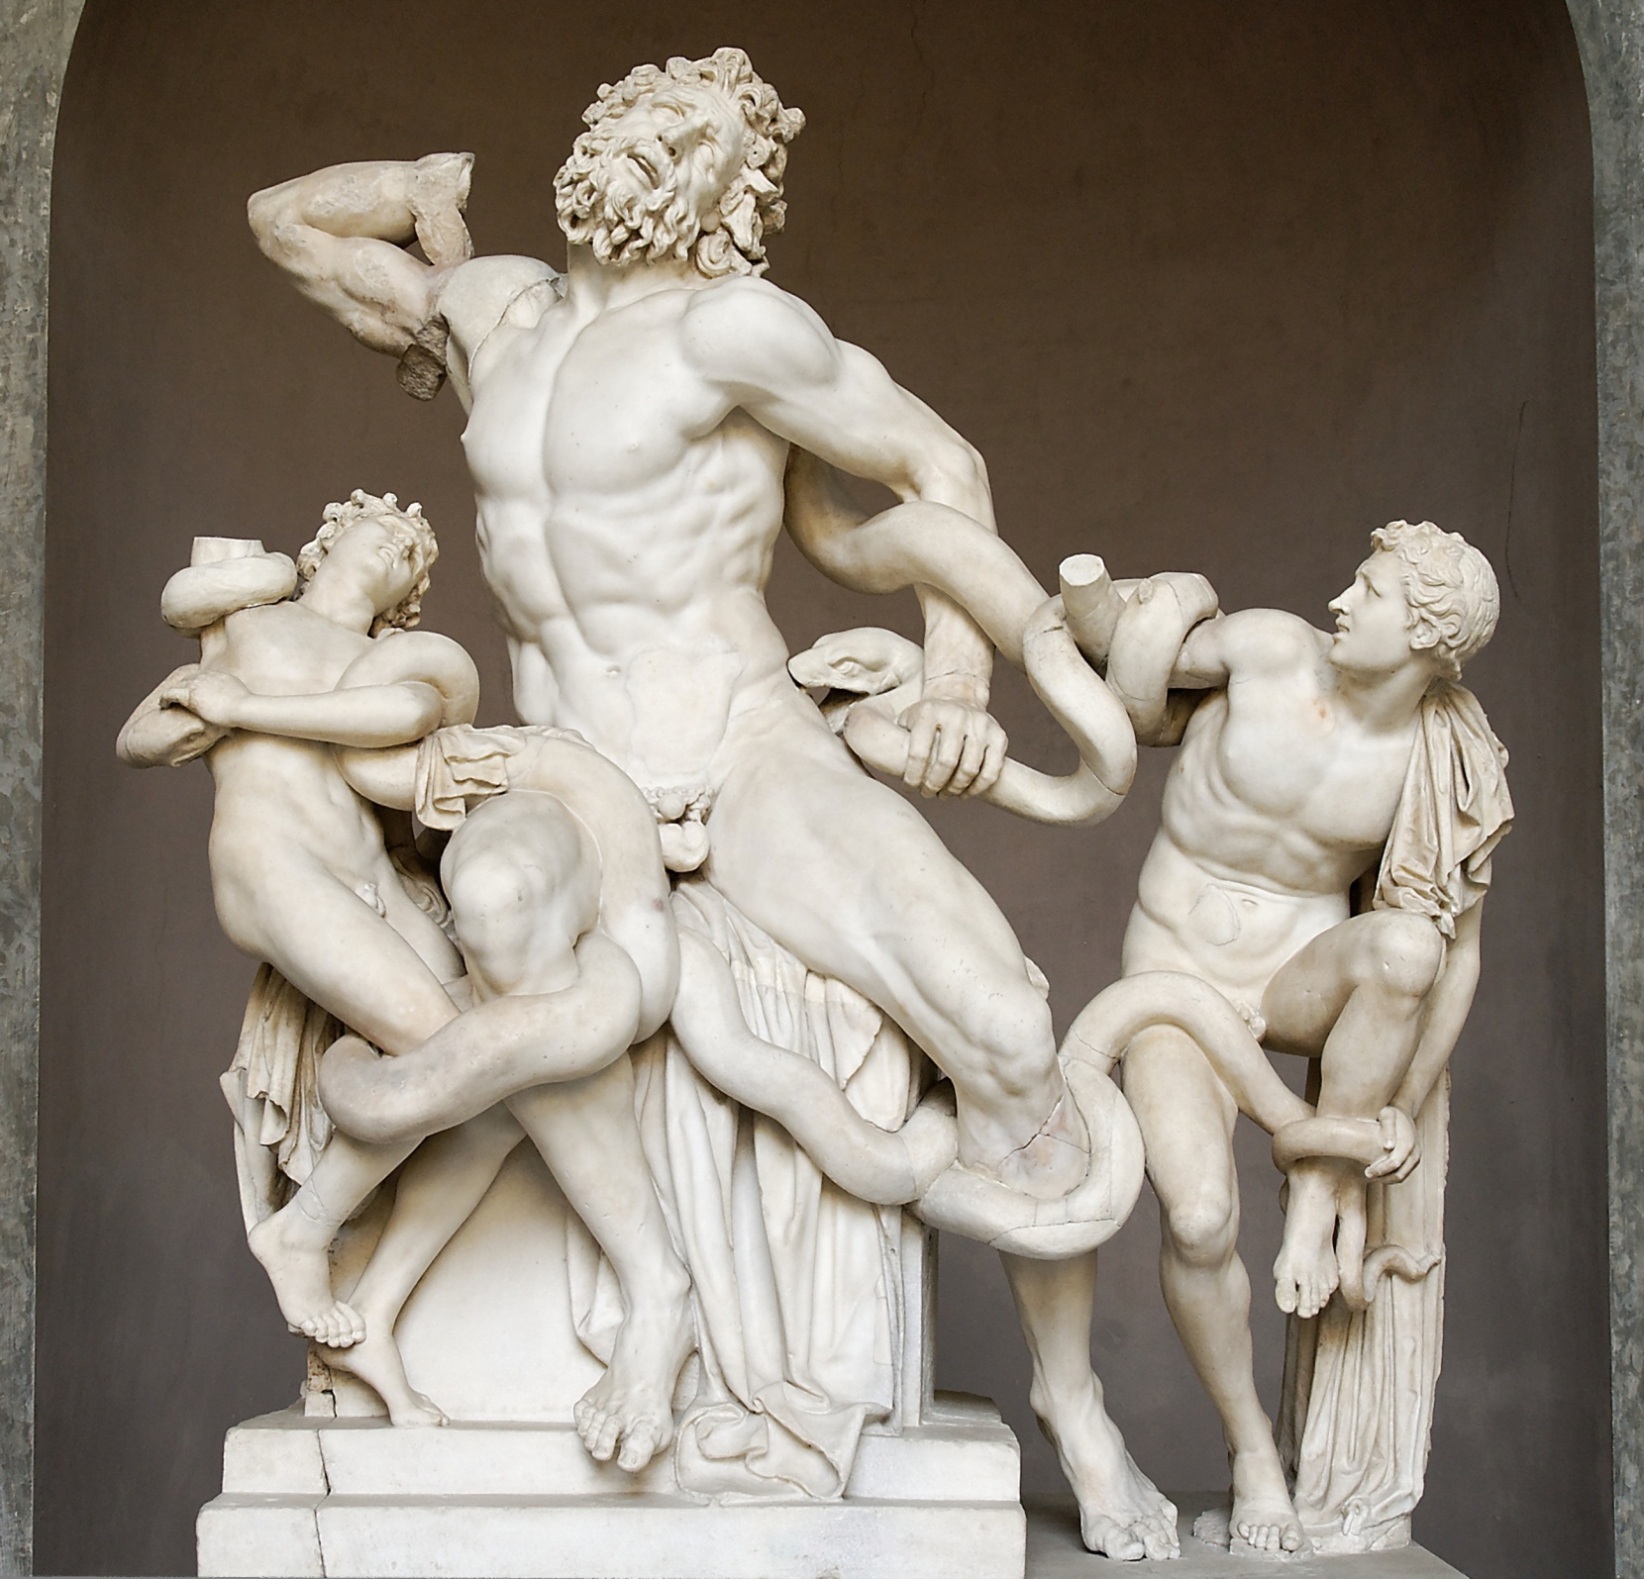
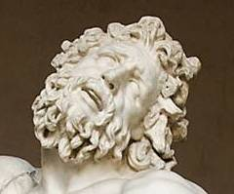
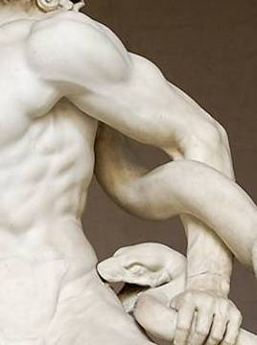
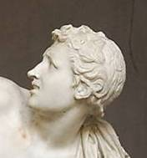

Slide 12
Four characteristics that defined their style
One:
glorified humans as the most important creatures in the universe
while the gods were often portrayed, they existed in the art for the benefit of humans
by glorifying the gods, they were glorifying themselves
subjects were idealized
represented the traits admired by the Greeks: strength, intelligence, pride, grace, and courage

Slide 13
Two:
art symbolized the peoples’ pride in their city-states
they were honoring their gods, eg., Athena for giving them life & good fortune
by building the Parthenon as a shrine for Athena they were showing their love for their city and their hope & wishes for continuing good fortune

Slide 14
Three:
all Greek art expressed Greek ideals of harmony, balance, order, and moderation
ideals emphasized by the Greeks in their day-to-day lives

Slide 15
Four:
Greeks also believed in combining beauty with usefulness → form & function
believed that the useful, the beautiful, the good were all closely bound together
wanted their art and even their furniture & their utensils to be both serviceable and beautiful

