Slide 1
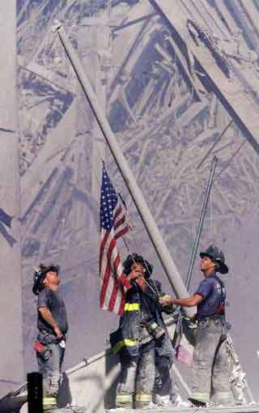
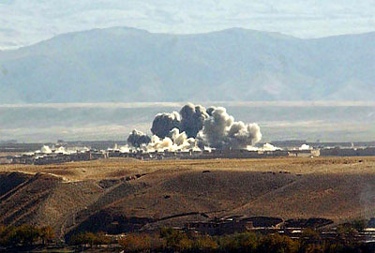
U.S. Wars in Afghanistan & Iraq
September 11, 2001 – U.S. is attacked by al-Qaeda
almost 3,000 Americans are killed in NYC, the Pentagon, and in Pennsylvania
“Today, our nation saw evil, the very worst of human nature…”
- George W. Bush, September 11, 2001
“I will not forget the wound to our country and those who inflicted it. I will not yield, I will not rest, I will not relent in waging this struggle for freedom and security for the American people…”
- George W. Bush, September 20, 2001
And so it begins…

Slide 2
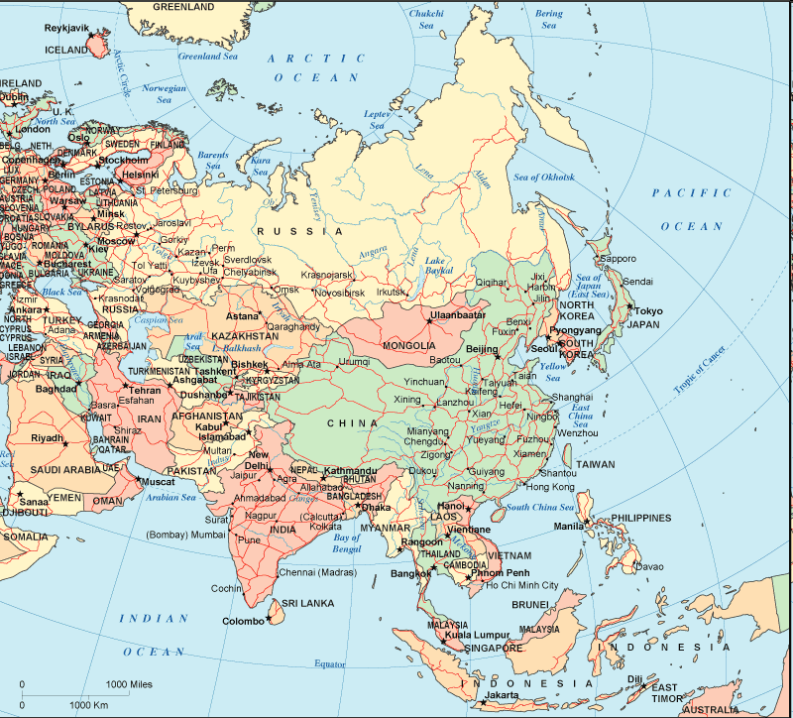
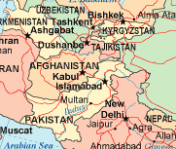
So how did it get to this point?
First - Afghanistan
A Brief History
Long history of as a crossroad
many different conquerors, including Alexander the Great
many different ethic people
main group are the Pashtuns – 50% of the population today
predominant religion is Islam

Slide 3
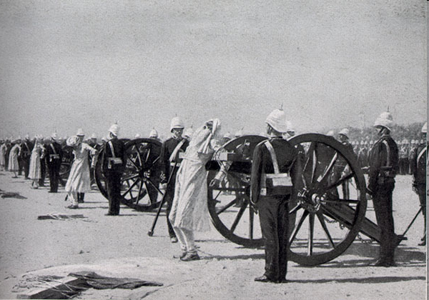
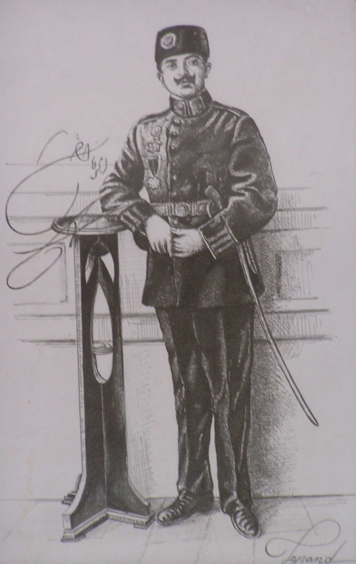
Brief History of Afghanistan, cont.
first taste of independence in 1747
however, Britain & Russia (the Great Game) vie for control in 1800s during Age of Imperialism
British control lasts until 1919 when Afghanistan declares its independence again
Britain then undermined the new king – Amanullah →overthrown in 1929
history of Afghanistan will be volatile for decades

Slide 4
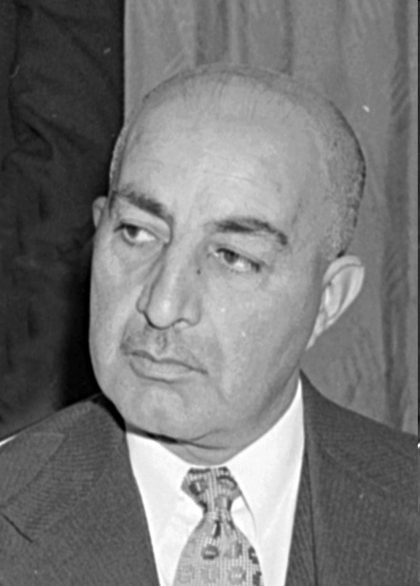
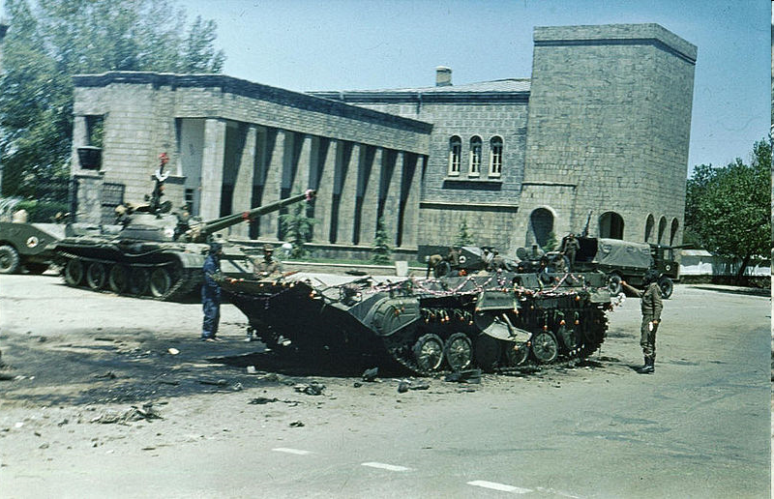
Brief History of Afghanistan, cont.
1973 Mohammed Daoud Khan overthrows cousin and becomes first president of Afghanistan – little changed
did institute some modernization and gave rights to women, including education
1978 – Daoud is assassinated by Peoples Democratic Party of Afghanistan (PDPA), pro-Moscow party

Slide 5
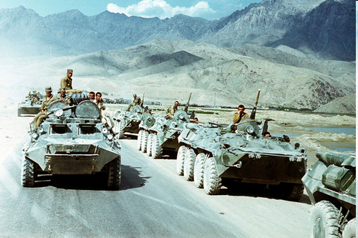
Brief History of Afghanistan, cont.
PDPA close to Moscow
despite progressive reforms, there is much corruption
much dissent
party tries to control moderate elements in party
Soviet Union invades in 1979 because PDPA is on verge of civil war and losing control
- U.S. initially pays little attention to overthrow of Daoud but becomes interested after Soviet invasion

Slide 6
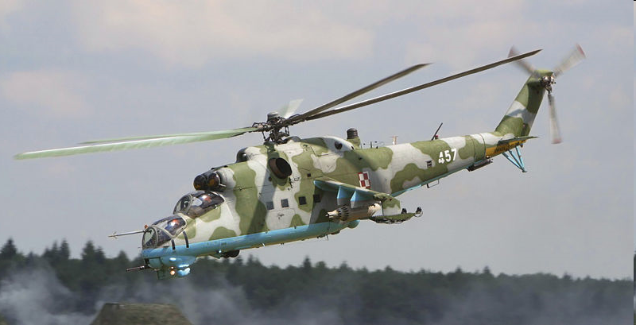
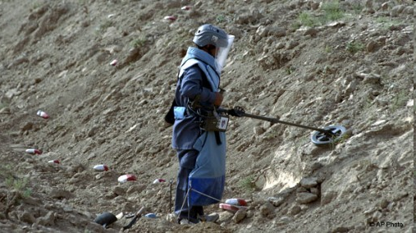
The Afghan-Soviet War
Soviet Union and PDPA v. Mujahideen – Islamic guerilla fighters
Brutal war
Soviets have superior air technology & use it to bomb villages killing numerous civilians
captured Soviet soldiers are brutalized
- Soviets respond with carpeting countryside with landmines – many are disguised as toys

Slide 7
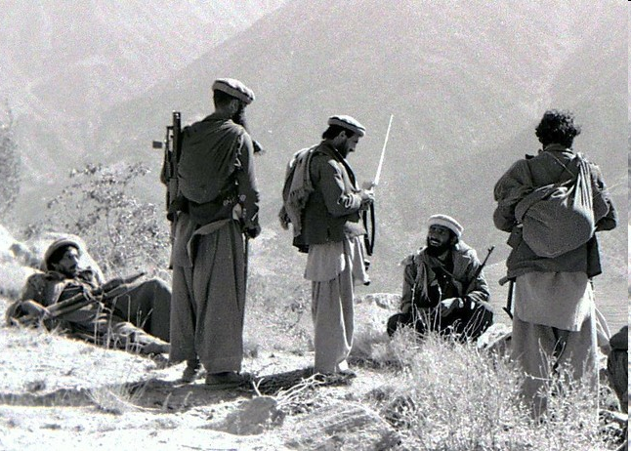
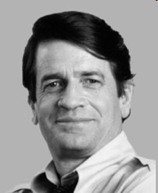
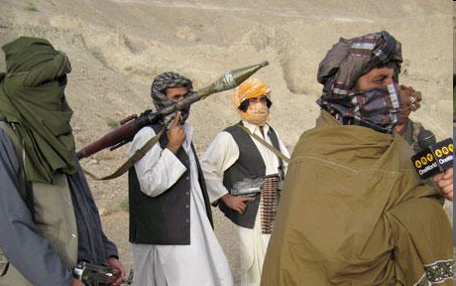
U.S. Involvement in Afghan-Soviet War
Soviets control all major cities but cannot control countryside – similar to Britain in 1800s
Representative Charlie Wilson (D – Tex) pushed for secret CIA funding to support Mujahideen
Billions of dollars of anti-aircraft and anti-tank weapons delivered into Afghanistan
turns tide of war against Soviet Union

Slide 8
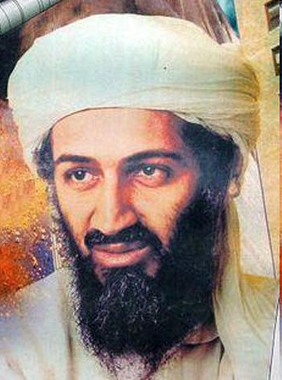
At the same time…
Osama bin Laden joins Abdullah Azzam to form Maktab al-Khadamat, a Mujahideen organization to fight Soviets
using his wealth, bin Laden established a base in Peshawar (North West Frontier Pakistan)
preaches return to strict Shari’a law and the need for violent jihad to cleanse religion
Wahhabi sect – anti-semitic & believes Shi’a Islam is heretical

Slide 9
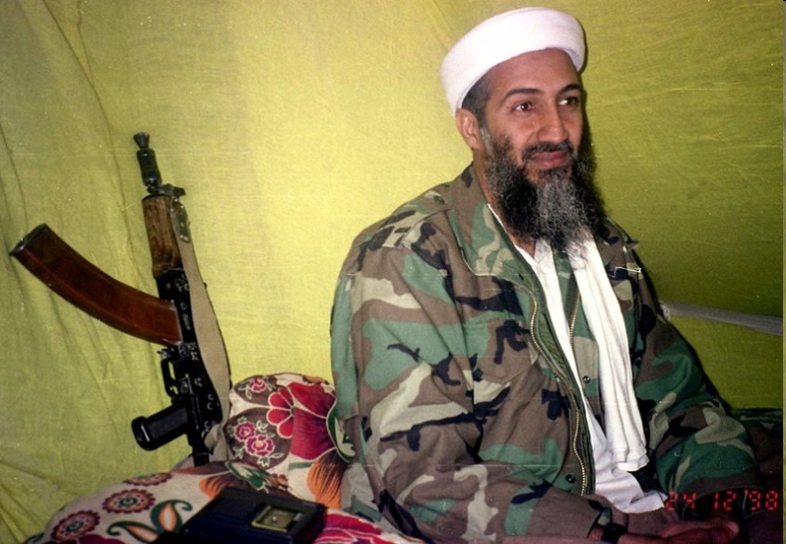
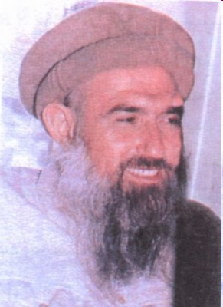
Bin Laden, cont.
bin Laden brings many jihad fighters into Afghanistan
establishes bases and camps in Afghanistan
receives aid from United States in form of anti-aircraft & anti-tank weapons
1988 – bin Laden splits from Maktab al-Khadamat b/c he wants more world-wide fight against “infidels” – forms al-Qaeda
Azzam is killed by a bomb in 1989 and group is absorbed into al-Qaeda

Slide 10
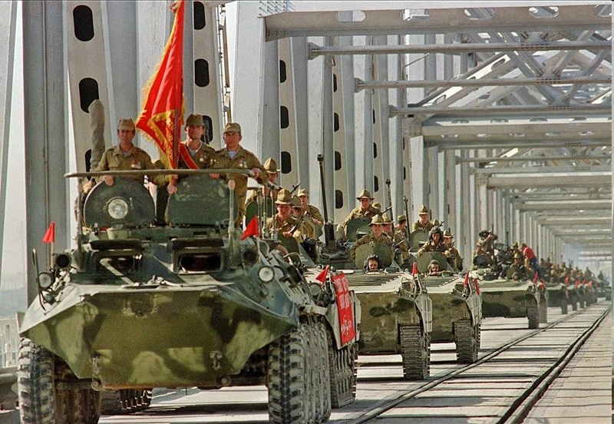
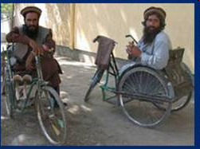
Withdrawal of the Soviet Union
1989 – Soviet Union leaves Afghanistan after terrible losses
est. 15,000 Soviet deaths
est. 400,000 wounded, injured, or sick
hundreds of aircraft and vehicles destroyed
est. 100,000 to 1 million Afghan fighters killed
4 million wounded or disabled (mostly civilians)
half of world’s refugees in 1980s were from Afghanistan

Slide 11
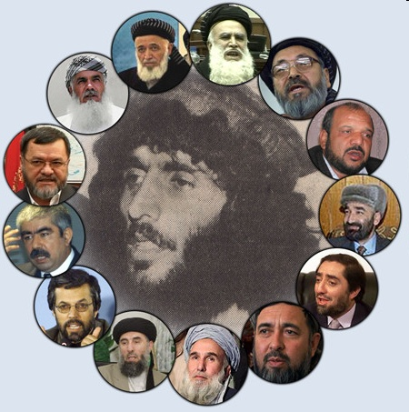
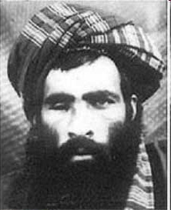
Civil War in Afghanistan
Mujahideen factions begins fighting each other for control
Afghanistan is divided into areas controlled by local warlords
1992 PDPA is defeated and communist influence in Afghanistan is over
U.S. abandons Afghanistan after Soviet withdrawal – Pakistani intelligence organization steps in – leans towards more conservative factions
creation of the Taliban

Slide 12
The Taliban
Taliban = the students
recruits came from madrassahs in Pakistan and Afghanistan and disillusioned mujahideens
drawn by pure vision of Islam offered by Mullah Muhammed Omar
railed against corruption, greed, factionalism
began to capture one city after another and controlled Kabul by 1996 - Mullah Omar declares Islamic Emirate of Afghanistan

Slide 13
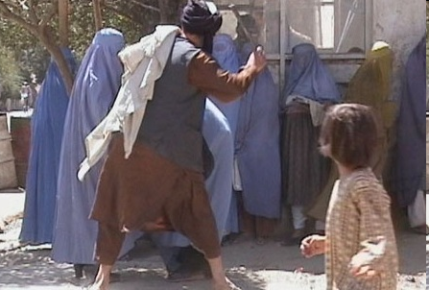
The Taliban
warlords form opposition to Taliban called Northern Alliance
control only 10% of Afghanistan in the north (duh!)
Mullah Omar impose shari’a law and take away rights from women – cannot attend school or work outside the home
A member of the Taliban’s religious police beating a woman in Kabul on 13 September 2001
create theocracy, ban TV, rid country of secularism & western influence
becomes isolated from rest of world – only country recognizing new Afghan government were Saudi Arabia, United Arab Emirates, and Pakistan

Slide 14
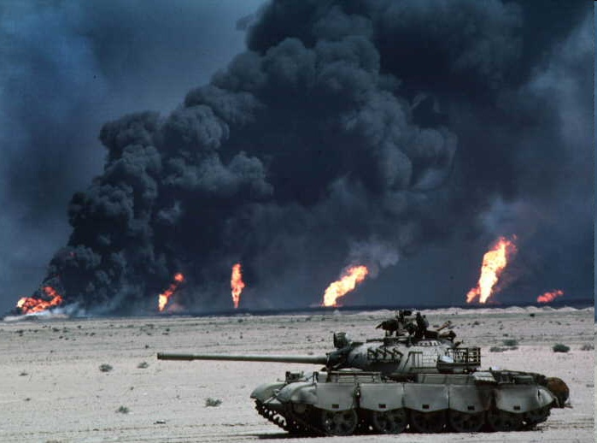
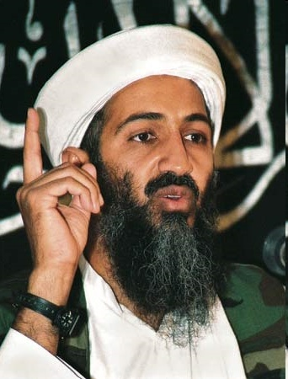
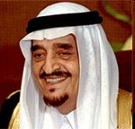
Now, back to Osama bin Laden
Bin Laden returns to Saudi Arabia as hero - “had brought down the mighty superpower” of the Soviet Union
after Iraqi invasion of Kuwait in August, 1990, bin Laden advises King Fahd against using foreign assistance to drive Iraq out of Kuwait
- advice ignored – begins making trouble for royal family
- denounces presence of American troops on Saudi soil – considered violation of sacred land

Slide 15
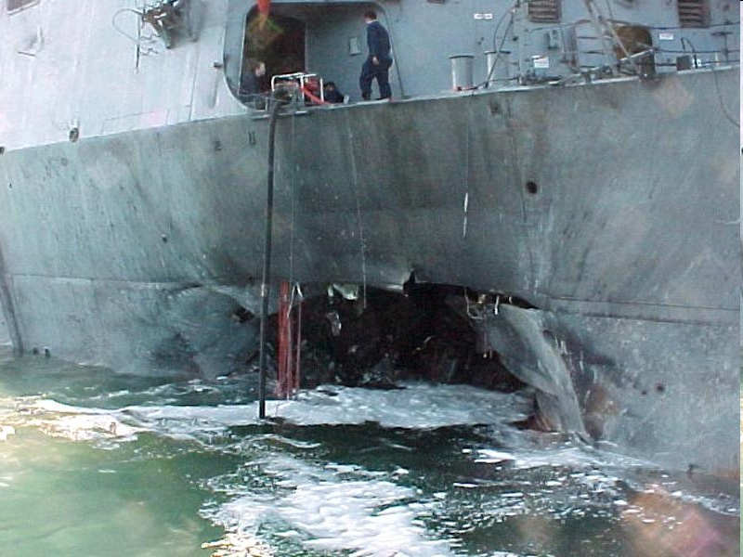
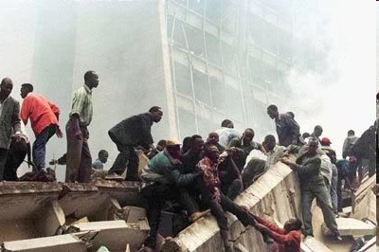
Osama bin Laden
banished from Saudi Arabia in 1992 – goes to Sudan and begins planning jihad against the United States
associates with radical Islamist group from Egypt
begins series of attacks against a number of targets throughout Middle East & Africa
- through pressure on Sudan from U.S., Egypt, and Saudi Arabia, Sudan expels bin Laden in 1996 – goes to Afghanistan & establishes close relationship with Mullah Omar

Slide 16
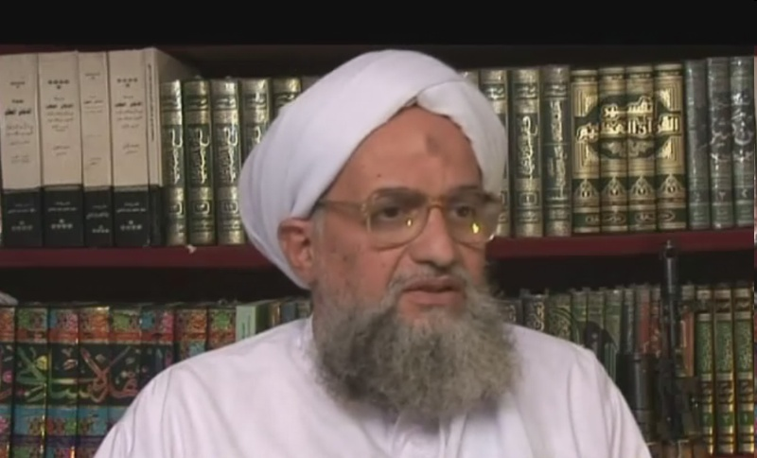
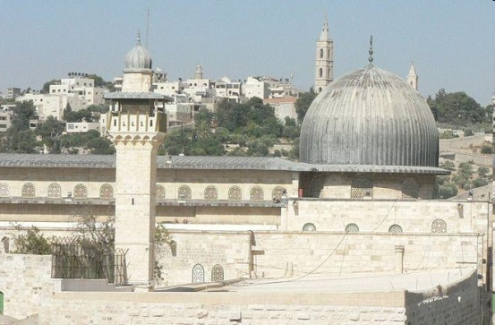
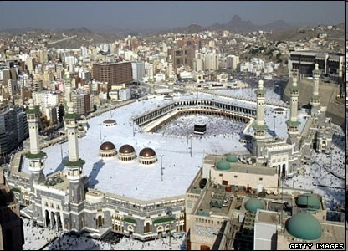
Osama bin Laden
1998 – with Ayman al-Zawahiri (many consider him the true brains of al-Qaeda), bin Laden issues fatwa (religious ruling) calling for:
Jihad against all Jews
killing of all North Americans & their allies
liberating the al-Aqsa Mosque in Jerusalem from the Jews & the Holy mosque in Mecca from the Americans
duty of all Muslims was to kill Americans

Slide 17
Osama bin Laden & September 11
"Allah knows it did not cross our minds to attack the towers but after the situation became unbearable and we witnessed the injustice and tyranny of the American-Israeli alliance against our people in Palestine and Lebanon, I thought about it. And the events that affected me directly were that of 1982 and the events that followed -- when America allowed the Israelis to invade Lebanon, helped by the U.S. Sixth Fleet. As I watched the destroyed towers in Lebanon, it occurred to me punish the unjust the same way (and) to destroy towers in America so it could taste some of what we are tasting and to stop killing our children and women.“
- Osama bin Laden, October 29, 2004 – admitting his involvement in September 11, 2001 attack

Slide 18
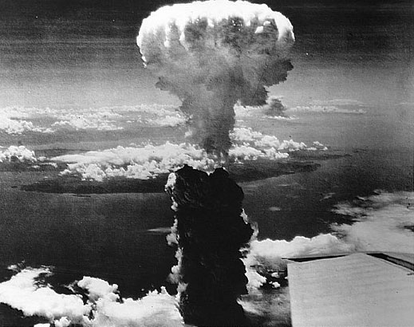
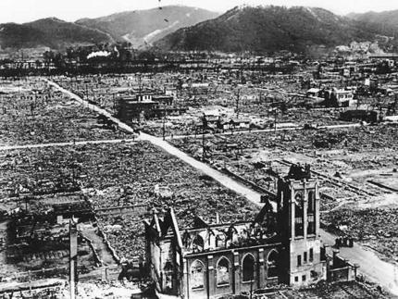
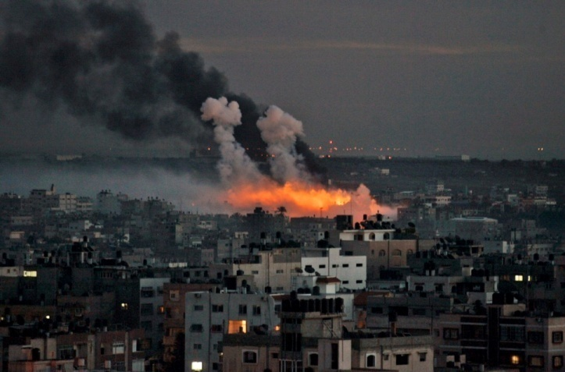
“American history does not distinguish between civilians and military, and not even women and children. They are the ones who used the bombs against Nagasaki. Can these bombs distinguish between infants and military?”
- Osama bin Laden, May 28, 2001
Your thoughts??

Slide 19
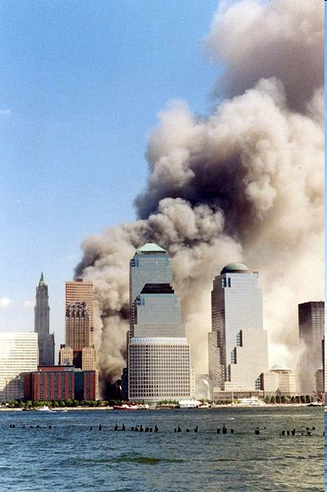
September 11, 2001
early morning Sept. 11 – 19 hijackers take control of 4 trans-American flights
American Airlines Flight 11 from Boston – crashed into North Tower of World Trade center at 8:46
United Airlines Flight 175 from Boston – crashed into South Tower at 9:03
American Airlines Flight 77 from Washington, DC – crashed into Pentagon at 9:37
United Airlines Flight 93 from Newark – crashed into field near Shanksville, Pennsylvania at 10:03 after passengers fight back – likely target was US Capitol

Slide 20
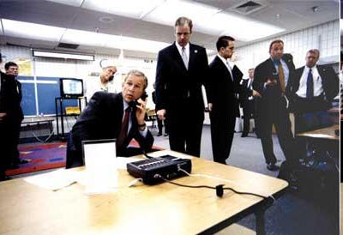
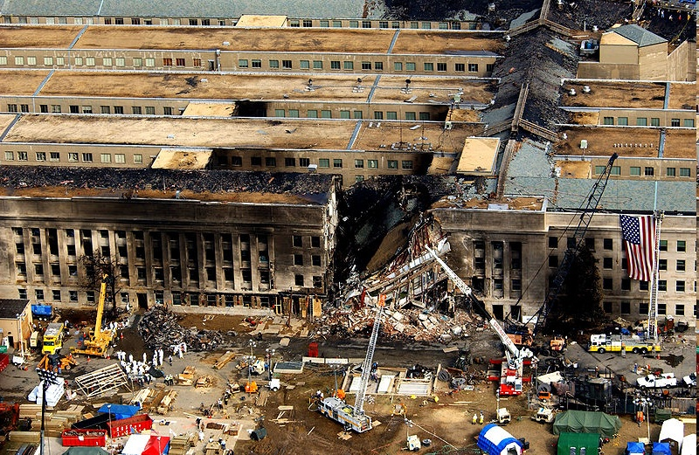
September 11, 2001
Casualties
246 on planes (227 passengers and crew members, 19 hijackers)
2,605 in NYC
125 at Pentagon
total – 2,976 victims, 19 hijackers
est. 17,400 civilians were in the building at time of attack – 87% escaped
411 emergency workers/first responders died – 343 FDNY firefighters/paramedics, 23 NYPD officers, 37 Port Authority officers, & 8 private EMTs
back

Slide 21
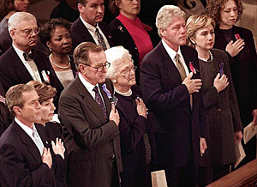
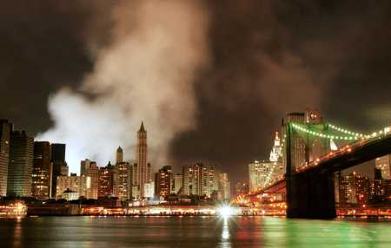
American Response
immediate worldwide reaction condemns act and pledges support for America
Sept 13 - Osama bin Laden is identified officially as prime suspect of attack and US promised a “sustained” military action to bring justice – bin Laden denies responsibility
Sept 14 – 50,000 reservists called to active duty, Taliban warns against attacking Afghanistan, names of hijackers released
National Cathedral, September 14
New York skyline on September 16, 2001

Slide 22
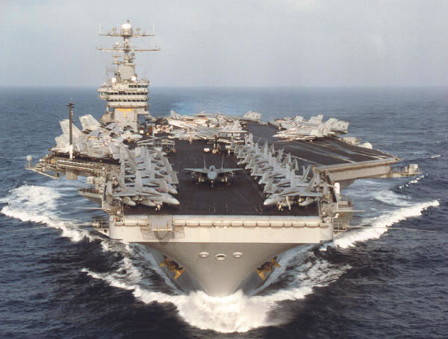
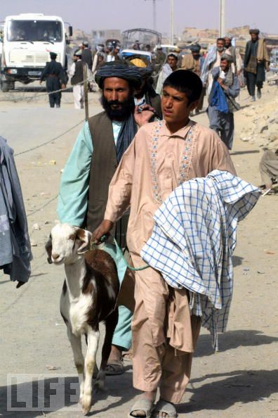
American Response
Sept 16 – Bush pledges a “crusade” against evil-doers
message delivered to Taliban through Pakistan to hand over Osama bin Laden or risk attack – refusals comes on Sept 21
Sept 20 – international support for attack grows
US aircrafts transported to Persian Gulf
Bush tells US military to be “prepared” because “The hour is coming when America will act and you will make us proud.”
Afghanis begin fleeing to border
Islamic clerics ask bin Laden to voluntarily leave Afghanistan

Slide 23
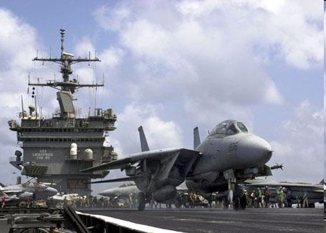
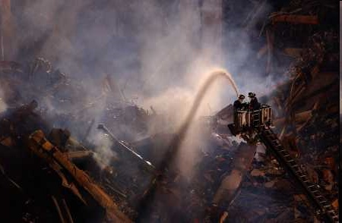
American Response
Sept 26 - U.S. and Pakistani officials agree on military preparations for combating bin Laden’s terrorist network in Afghanistan
Sept 30 – Afghanistan acknowledges they communicate with bin Laden and are keeping him safe – bin Laden renews calls for attacks on Jews and Americans
Oct 4 – Great Britain Prime Minister Tony Blair outlines case against bin Laden and Pakistan becomes 1st Muslim nation to say there is enough evidence to incriminate al-Qaeda
USS Enterprise
Smoldering ruins of WTC, October 2

Slide 24
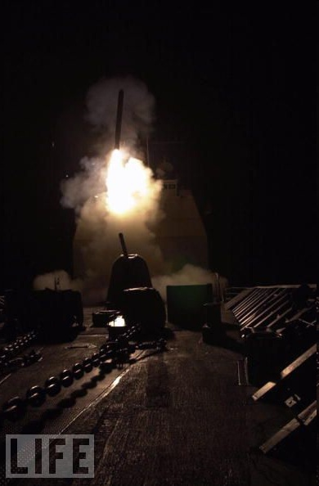
Operation Enduring Freedom
Oct 6 – Bush warns Afghanistan “time is running out” and to hand over all terrorists; they refuse
Oct 7 – US and Great Britain begin missile strikes against Taliban and al-Qaeda bases; Bush says, “We will not waver, we will not tire, we will not falter, and we will not fail.”

