Slide 1
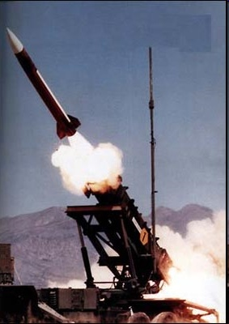
Operation Desert Storm
war last only 6 weeks
Saddam tries to draw Israel into war by firing 39 Scud missiles at Israel –causes some damage but Israel refrains from responding
hoped Israel’s participation would fragment coalition
liberate Kuwait on Feb. 22
cease-fire announced on Feb. 28 after crossing into Iraq
379 coalition deaths (294 US deaths)
est. 20-30,000 Iraqis killed

Slide 2
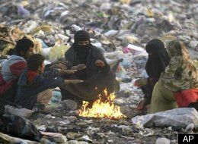
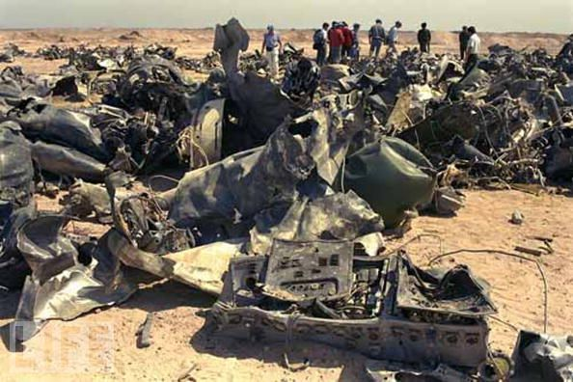
Post-Desert Storm
UN Security Council Resolution 661 imposes economic sanctions including trade embargo, excluding medical supplies, food and other items of humanitarian necessity
restitution ordered to Kuwait
UN Resolution 687 calls for removal of weapons of mass destruction (WMD) for lifting of embargo
sanctions and gov’t policies lead to hyperinflation, widespread poverty and malnutrition

Slide 3
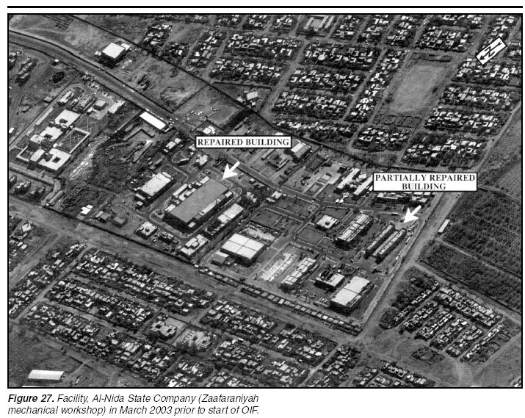
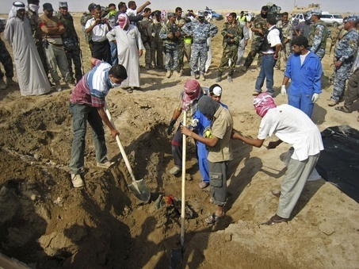
Post-Operation Desert Storm
Iraq gives limited/no cooperation to UN inspection teams
forces occasional bombings of suspected sites of WMD manufacture and storage
- US encourages rebellions against Saddam by Kurds and Shi’as – Saddam uses chemical weapons to suppress rebellions
Mass graves found in 2003

Slide 4
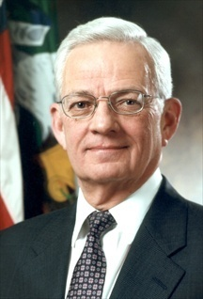
Iraq Crisis 2001-2003
According to Treasury Secretary Paul O’Neil, ten days after assuming office, Bush instructed his aides to look for a way to overthrow the Iraqi regime
Plan for post-Saddam Iraq
Foreign Suitors for Iraqi Oilfield contracts
- after 9/11, it becomes clear Bush Admin. intends to remove Saddam from power
- administration begins to make case Iraq is linked to al-Qaeda
UN Resolutions bar Iraq from possession of WMD – have right to inspect
US demands inspections
Condoleezza Rice

Slide 5
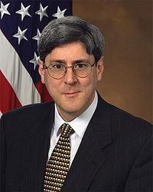
Iraq Crisis 2001-2003
The American Case Against Saddam
new office created in the White – Office of Special Plans (OSP) – function was to deliver raw, un-vetted intelligence to Vice President Cheney
intelligence was often given to media for mass dissemination
Doug Feith
Paul Wolfowitz
yellowcake uranium story
based on British documents
key element in Bush’s State of the Union Address in Jan., 2003
“The British government has learned that Saddam Hussein recently sought significant quantities of uranium from Africa.”

Slide 6
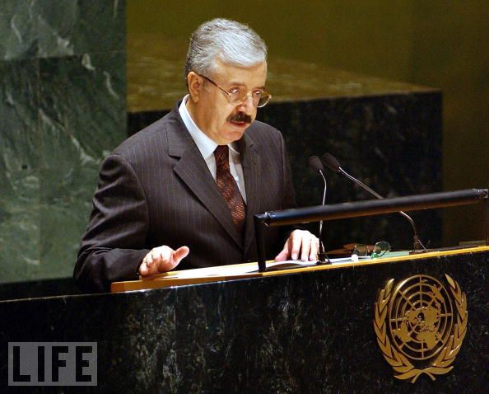
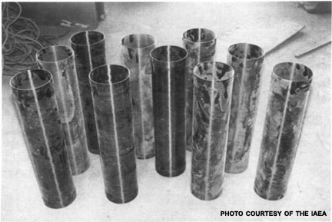
Iraq Crisis 2001-2003
The American Case Against Saddam
Naji Sabri, Foreign Minister of Iraq, worked as agent for French Intelligence
informed CIA in 2003 Saddam had hidden poison gas among Sunni tribesmen
nuclear ambitions but no real program
no stockpiles of biological agents
2002 leaked intelligence published in NY Times claiming aluminum tubes for centrifuges to enrich uranium were intercepted in Jordan bound for Iraq
becomes key element in Colin Powell’s address to UN on February 24, 2003 pushing for war

Slide 7
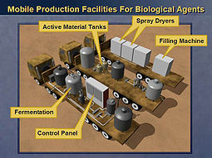
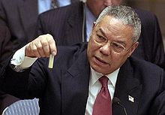
Iraq Crisis 2001-2003
The American Case Against Saddam
Powell tells of mobile biological weapons lab made by Iraq
claims anthrax production in Iraq
Secretary of State Colin Powell holding a bottle of anthrax at UN
numerous UN resolutions passed to force Iraqi compliance with weapons inspectors
US claims Iraq has failed to appropriately comply
September 24, 2002 – Tony Blair, Prime Minister of Great Britain claims “he has existing and active military plans for the use of chemical and biological weapons, which could be activated within 45 minutes”

Slide 8
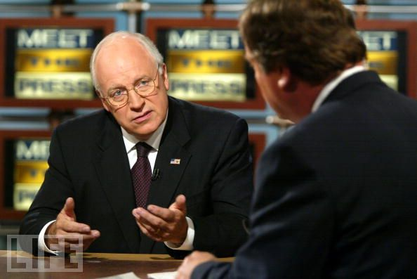
Iraq Crisis 2001-2003
The American Case Against Saddam
Iraq-al-Qaeda link → “The Czech interior minister said today that an Iraqi intelligence officer met with Mohammed Atta, one of the ringleaders of the September 11 terrorists attacks on the United States, just five months before the synchronized hijackings and mass killings were carried out.”
Dick Cheney on Meet the Press, Dec 9, 2001
- Czech intelligence have backed away from these claims and even Cheney admits today these reports were never confirmed

Slide 9
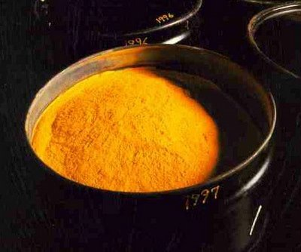
Iraq Crisis 2001-2003
The American Case Against Saddam
the Yellowcake Deal – Feb, 2002 – Ambassador Joseph Wilson investigates claim and finds documents making the claim were forgeries
White House responds by “outing” Wilson’s wife (ask me “Who is Valerie Plame?”) as a CIA operative – ruining her career as an agent
secret British memo says “Bush wanted to remove Saddam, through military action, justified by the conjunction of terrorism and WMD. But the intelligence and facts were being fixed around the policy”

Slide 10
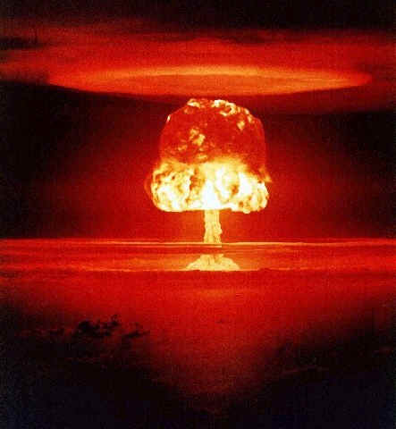
Iraq Crisis 2001-2003
The American Case Against Saddam
the aluminum tubes – Bush claims this is proof of a nuclear program
Department of Energy report to President in 2002 on the tubes conclude they “seem to better match our expectations for a conventional Iraqi military buy than a major purchase for a clandestine weapons-of-mass destruction program.”
report ignored and dismissed
Bush later laments his biggest regret was “the intelligence failure in Iraq”

Slide 11
Iraq Crisis 2001-2003
The American Case Against Saddam
the mobile biological labs – based upon the intelligence from Iraqi defector in 1999
German Intelligence warned CIA to not trust reports from this source – unreliable
Iraq Survey Group (ISG) in 2004 confirmed no mobile labs existed
ISG reports they found evidence of WMD-related program activities but no biological, chemical, or nuclear weapons
“What everyone was talking about is stockpiles produced after the end of the last Gulf War and I don’t think there was a large-scale production program in the nineties… It turns out that we were all wrong, probably in my judgment, and that is most disturbing.”
David Kay, head of the ISG

Slide 12
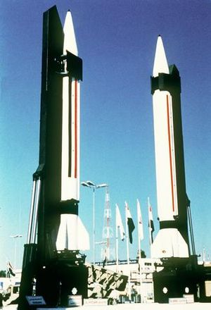
Iraq Crisis 2001-2003
The American Case Against Saddam
Blair’s 45-minutes claim – no WMD, no ability to strike in 45 minutes
no Scud missile attacks during war; 88 Scuds launched during first Gulf War
Sabri’s claim that Iraq had no biological or nuclear capabilities were confirmed
found some old chemical weapons but experts believe they posed no imminent threat

Slide 13
Iraq Crisis 2001-2003
The Inspections
UN Resolution 1441 forced Iraq to accept new round of weapons inspection
Hans Blix, Swedish diplomat & former head of the International Atomic Energy Commission, headed inspection team
reported Iraq was uncooperative – “If Iraq had provided the necessary cooperation in 1991, the phase of disarmament -- under resolution 687 -- could have been short and a decade of sanctions could have been avoided.”
did not find WMD – “There were about 700 inspections, and in no case did we find weapons of mass destruction.”
claimed his team needed more time to confirm whether the little they found were fragments of dead program or the start of a real WMD program

Slide 14
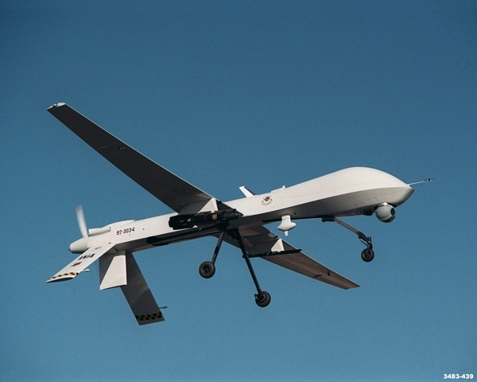
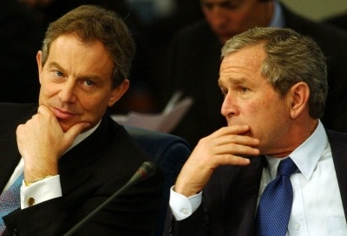
The War
Oct., 2002 – Senate told Saddam has unmanned aerial vehicles (UAV) capable of delivering chemical attacks (it did not)
Congress votes to authorize the President the power to use armed force against Iraq
Jan., 2003 – Bush & Blair make a secret deal to carry out the invasion regardless of whether WMD were discovered by UN weapons inspectors
Bush also tells Blair he does not expect warfare between the different religious factions in Iraq after the removal of Saddam
Tony Blair and George Bush, January 31, 2003

Slide 15
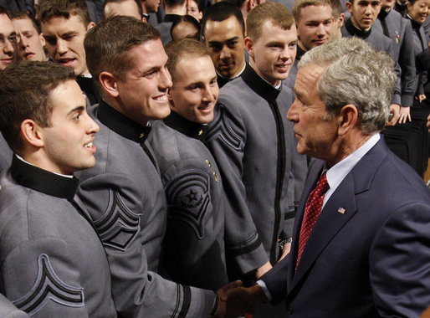
The War
Bush Doctrine
preemptive strikes against potential enemies
promoting democratic regime change
We cannot defend America and our friends by hoping for the best. We cannot put our faith in the word of tyrants, who solemnly sign non-proliferation treaties, and then systemically break them. If we wait for threats to fully materialize, we will have waited too long — Our security will require transforming the military you will lead — a military that must be ready to strike at a moment’s notice in any dark corner of the world. And our security will require all Americans to be forward-looking and resolute, to be ready for preemptive action when necessary to defend our liberty and to defend our lives.
- George Bush, June 1, 2002 at USMA Graduation

Slide 16
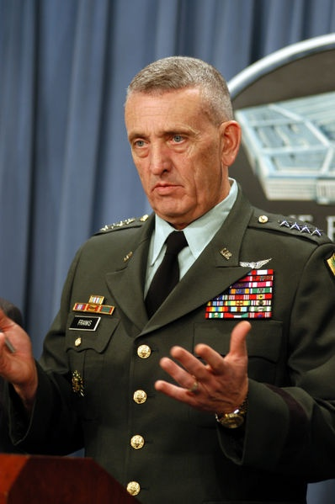
Operation Iraqi Freedom
invasion of Iraq begins on March 20, 2003 under command of General Tommy Franks
Objectives
end the Hussein regime
eliminate Iraqi WMD
eliminate whatever Islamist militants could be found
obtain intelligence on militant networks
distribute humanitarian aid
secure Iraq’s petroleum infrastructure
assist in creating a representative but compliant government as a model for other Middle East nations.

Slide 17
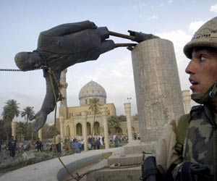
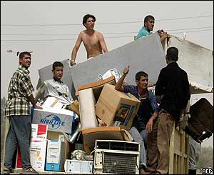
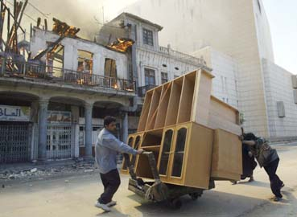
Operation Iraqi Freedom
Iraqi military offers some resistance but Coalition Forces quickly roll into Baghdad
April 9 –Baghdad falls to US troops – Ba’ath Party and Saddam abandon city
fall of Saddam is followed by gratitude and looting of government buildings
250,000 tons of ammunition was also looted
Rumsfeld’s response – “Stuff happens.”

Slide 18
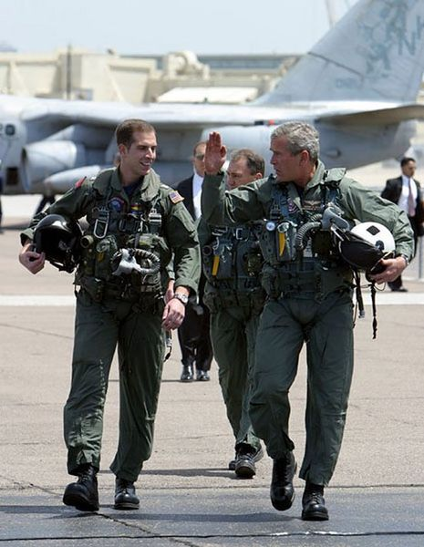
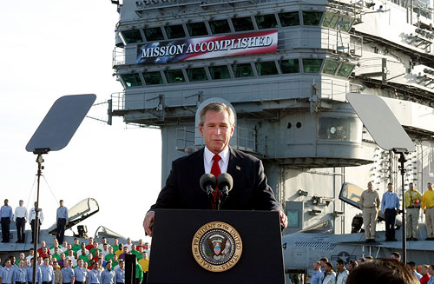
Operation Iraqi Freedom
Mission Accomplished
May 1, 2003 – President Bush declares major combat operations in Iraq are over
will stir controversy because resistance to American occupation will begin
criticized for politicizing the war
did not find weapons of mass destruction

Slide 19
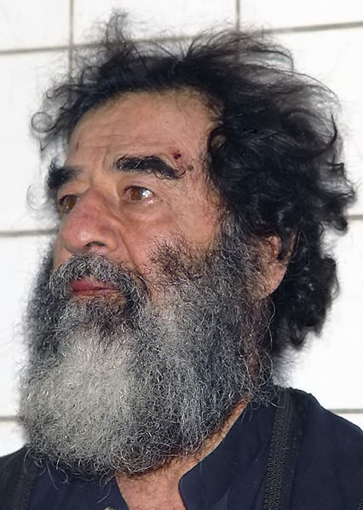
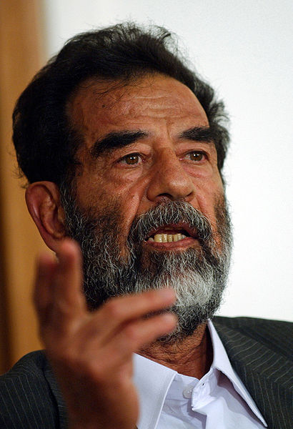
Operation Iraqi Freedom
Okay, let’s get to the end of this presentation and skip all the details – Saddam’s government falls and over time most of his key officials will be captured or killed
Saddam is captured on December 14, 2003
charged with the torture and murder of 182 people after failed assassination attempt in 1982
found guilty and executed on December 30, 2006

Slide 20
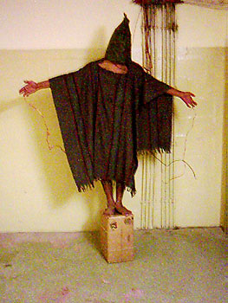
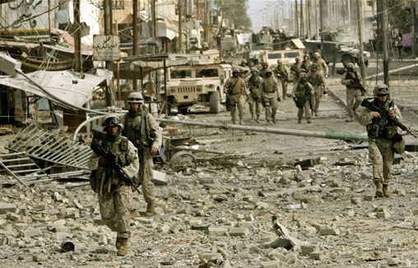
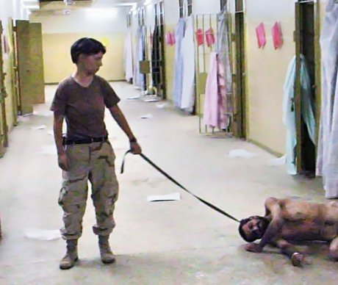
Operation Iraqi Freedom
Constitution drafted in October , 2005
current government takes over May, 2006
meanwhile – Abu Ghraib
Fallujah
Blackwater scandal
resistance grows – sectarian violence, civil war

Slide 21
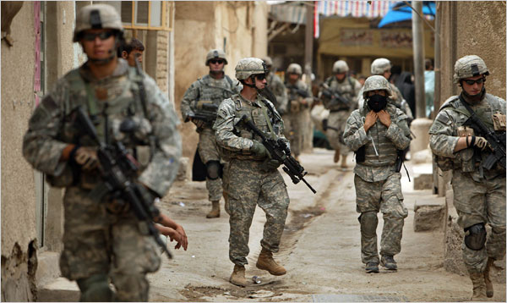
The Surge
January 2007
increase troop levels by over 20,000
however included winning hearts and minds of the Iraqi people through
building relationships
preventing civilian casualties
compromising with and even hiring some former enemies
results have been successful as bombings and attacks have decreased
Complete withdrawal – Oct. 21, 2011

Slide 22
Coalition Military Fatalities By Year –
Operation Iraqi Freedom
Afghanistan Coalition Military Fatalities By Year – Operation Enduring Freedom
Year | US | UK | Other | Total
2003 | 486 | 53 | 41 | 580
2004 | 849 | 22 | 35 | 906
2005 | 846 | 23 | 28 | 897
2006 | 823 | 29 | 21 | 873
2007 | 904 | 47 | 10 | 961
2008 | 314 | 4 | 4 | 322
2009 | 149 | 1 | 0 | 150
2010 | 60 | 0 | 0 | 60
2011 | 54 | 0 | 0 | 54
2012 | 1 | 0 | 0 | 1
Total | 4486 | 179 | 139 | 4804
Year | US | UK | Other | Total
2001 | 12 | 0 | 0 | 12
2002 | 49 | 3 | 18 | 70
2003 | 48 | 0 | 10 | 58
2004 | 52 | 1 | 7 | 60
2005 | 99 | 1 | 31 | 131
2006 | 98 | 39 | 54 | 191
2007 | 117 | 42 | 73 | 232
2008 | 155 | 51 | 89 | 295
2009 | 317 | 108 | 96 | 521
2010 | 499 | 103 | 109 | 711
2011 | 418 | 46 | 102 | 566
2012 | 45 | 10 | 12 | 67
Total | 1909 | 404 | 601 | 2914
Source : http://icasualties.org/
Defense department
How many people died on September 11, 2001?

Slide 23
Total Civilian Deaths in Iraq - 95,751 – 104,456, as of March 14, 2010
Deaths per day from suicide attacks and vehicle bombs
Deaths per day from gunfire / executions

Slide 24
Source | Iraqi casualties | March 2003 to...
Iraq Family Health Survey | 151,000 violent deaths. | June 2006
Lancet survey | 601,027 violent deaths out of 654,965 excess deaths. | June 2006
Opinion Research Business survey | 1,033,000 violent deaths as a result of the conflict. | August 2007
Associated Press | 110,600 violent deaths | April 2009
Iraq Body Count | 94,902 – 103,549 violent civilian deaths as a result of the conflict. | December 2009

